Slide 1
ONLINE TEACHING EVALUATION 2.0
Spring 2009 Pilot
DePaul University
Instructions for Students

Slide 2
Accessing the evaluations
You will be able to access online teaching evaluations (OTE) in two different ways
  Directly through an email message sent to you by the system
  Through campus connect
The following slides guide you through the necessary steps to complete your evaluations

Slide 3
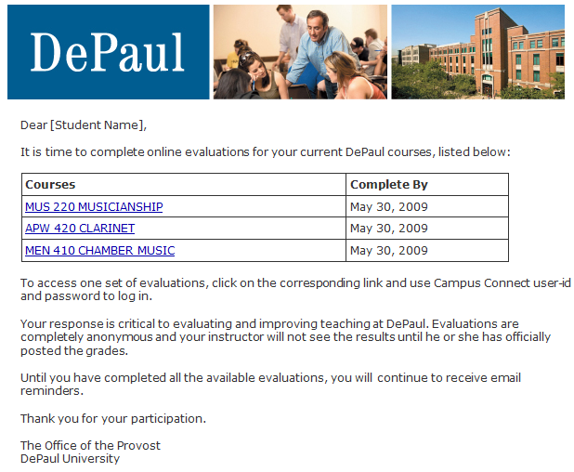
Accessing OTE through email – step1
You will receive an email message as shown here
Click on the link corresponding to the course you intend to evaluate

Slide 4
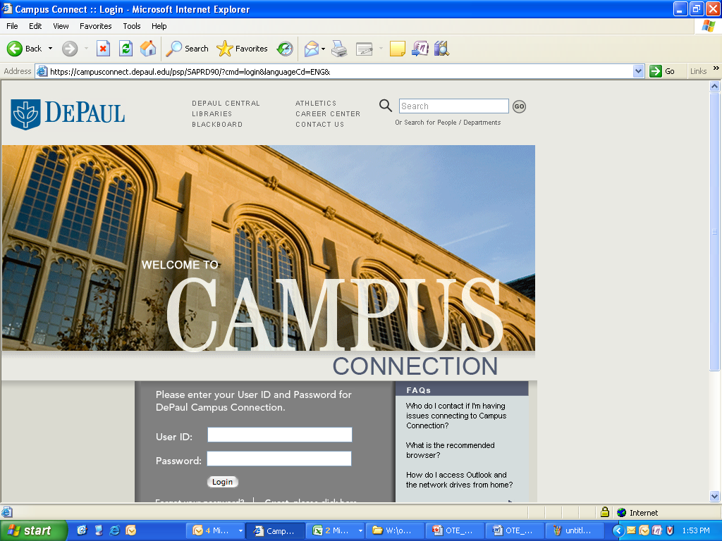
Accessing OTE through email – step2
The link will take you initially to campus connect for authentication
Log into campus connect with your usual user ID and password

Slide 5
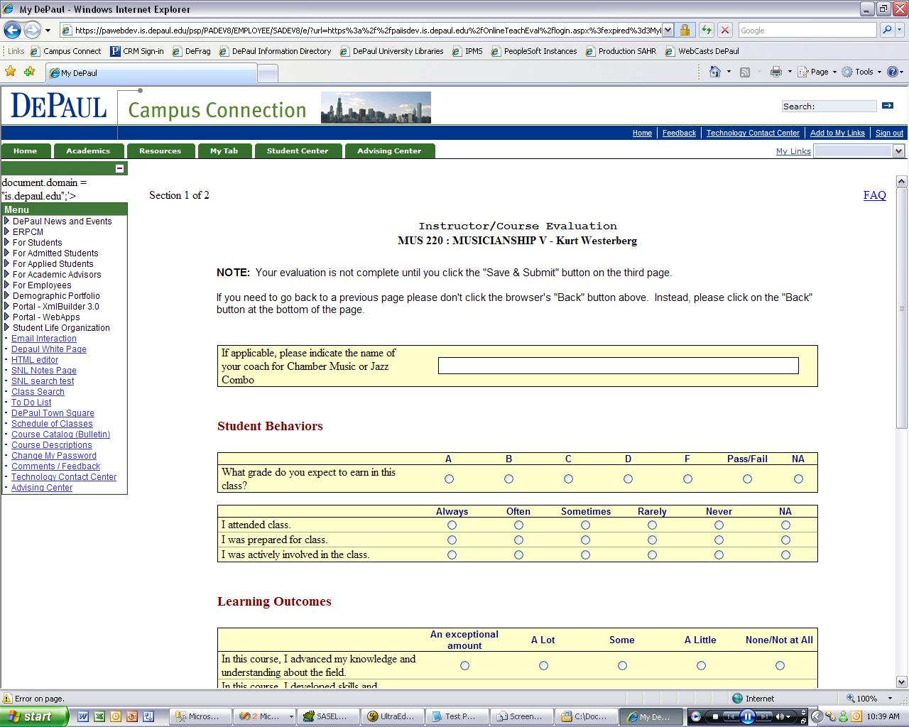
Accessing OTE through email – step 3
Read the instructions at the top and begin filling your evaluation.
You can click on FAQ for help.
Please call TCC (Help Desk) at 312-362-8765 if you encounter any technical difficulties
Notes:
5

Slide 6
Accessing the evaluations
OTE can also be accessed directly through campus connect, without using links provided in the email messages
The following slides will guide you through this access approach

Slide 7
Accessing OTE through campus connect – step1
Point your browser to campusconnect.depaul.edu
Log into campus connect with your usual user ID and password

Slide 8
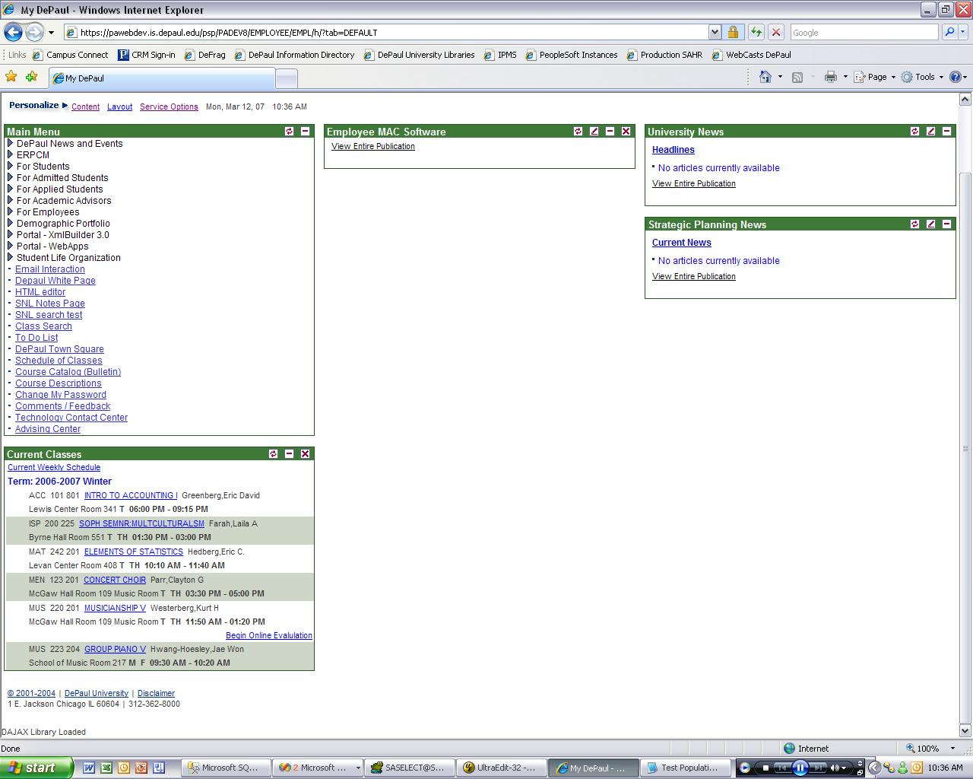
Accessing OTE through campus connect – step2
Locate the “Current Classes” pagelet. You might need to scroll down a bit before you see it.
If you can see the current classes pagelet, go to step 5

Slide 9
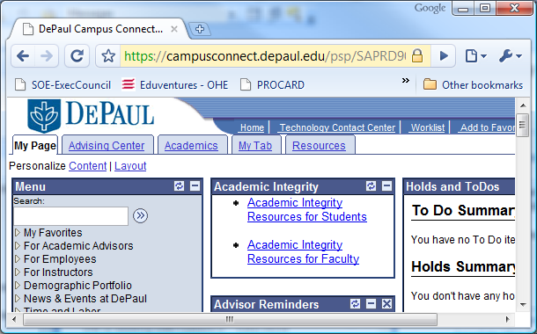
Accessing OTE through campus connect – step3
If you cannot see the Current Classes pagelet
in your Home Screen, look at the top left corner of the page and click on
Personalize Content

Slide 10
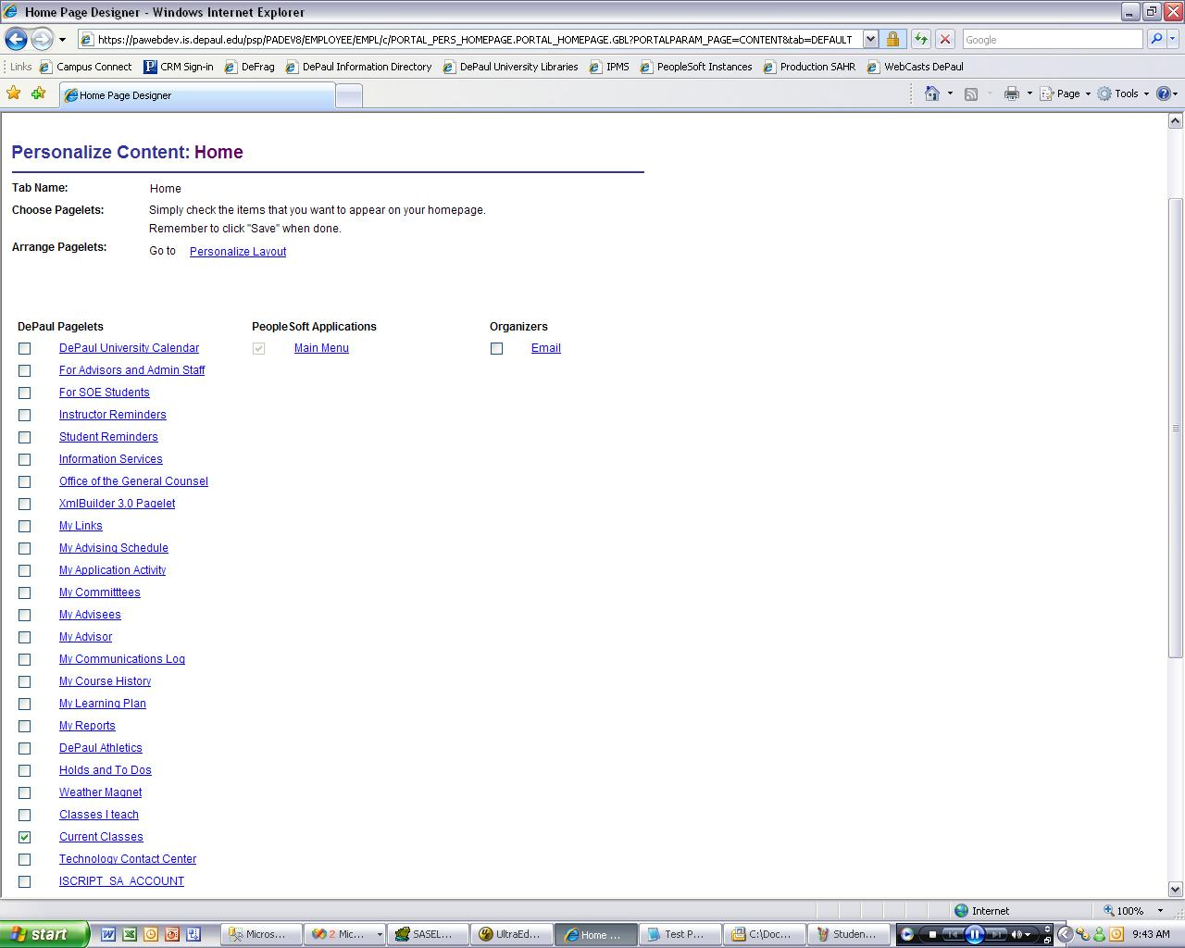
Accessing OTE through campus connect – step 4
Check the box for “Current Classes”
Click on “Save”

Slide 11
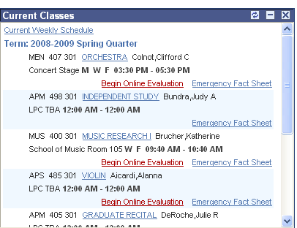
Accessing OTE through campus connect – step 5
In the “Current Classes” pagelet, locate the course you would like to evaluate
Click on “Begin Online Evaluation”

Slide 12
Accessing OTE through campus connect – step 6
Read the instructions at the top and begin filling your evaluation.
You can click on FAQ for help.
Please call TCC (Help Desk) at 312-362-8765 if you encounter any technical difficulties

