Slide 1
GEO 241: Geographic Information Systems I
Week 1: Syllabus, Introductory GIS Concepts and Data Models

Slide 2
Syllabus
Office Hours: Thu 5:00 pm– 6:00 pm and by appointment
Office Location:
Lincoln Park: Mon-Fri : 990 W Fullerton Ave., 3rd Floor, Suite 3140
Lab Assistant: Mike Jersha
Email : mikejersha@gmail.com
Lab hours: TDB
Course website: http://gis.depaul.edu/ngulasingam/GEO241.htm
Objective
Recommended textbook and required accessories
Schedule, assignments, activities, and grading
Important notices
GIS lab usage: - Availability
- SAC 224 Lab will be closed on the first week-end of each quarter

Slide 3

What is GIS?
“What is GIS” – a short video
Notes:
GIS – Set of tools that help
- collect
- store
- analyze &
- represent Spatial and other data
Powerful data visualization tool

Slide 4
What is GIS? (Contd.)
“GIS is a set of computer tools that aid in collection, storage, analysis and representation of spatial data and information.”
GIS is a powerful
- data visualization tool
- data analysis tool
- investigative tool
- decision making tool
Notes:
GIS – Set of tools that help
- collect
- store
- analyze &
- represent Spatial and other data
Powerful data visualization tool

Slide 5
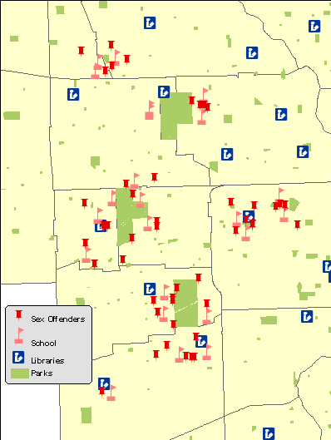
Examples
Notes:
Sex offenders are located in areas where children congregate?
This map/information will be useful for parents, schools (to identify bus stops, student pick-up/drop-off locations) and law enforcement officials.

Slide 6
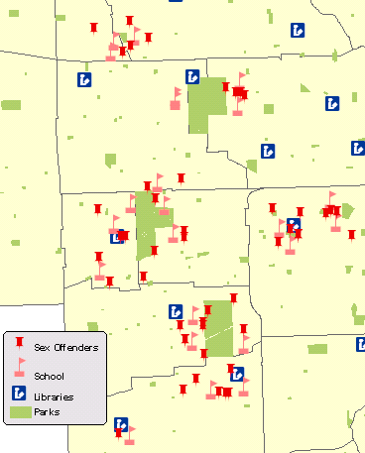
Purpose of Maps
Display data
Highlight relationships
Illustrate analysis and results
Share information
Make decision
Notes:
Information – Locations of schools, libraries, parks and sex-offenders
Display Data – Display the – Locations of schools, libraries, parks and sex-offenders on the map
Highlight important relationship – where they are clustered, dispersed
Illustrate analysis and share info – the map itself.
Decision – Parents and school to provide safe passage for kids; law enforcement to better monitor and petrol the area

Slide 7
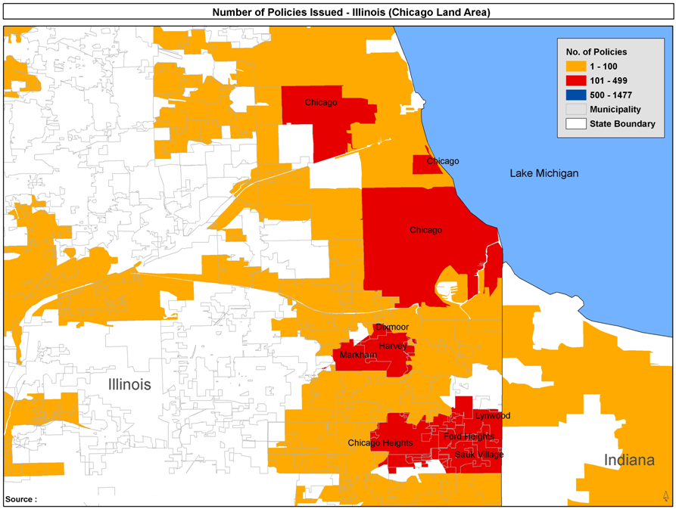
Examples (Contd.)
Notes:
Investigative tool

Slide 8
GIS Map
Have you seen GIS maps being used anywhere?
Where? How?
Notes:
News – Weather
Driving Directions / Atlas
Find point of interests / LBS
CTA/RTA Map
Map of the university / Mall
Geocashing
Baseball stadium – seating
TV Shows – Crime shows to do geographic profiling, profile people etc.

Slide 9
GIS Map
Have you seen GIS maps being used anywhere?
Where? How?
  TV News : Weather, Election, Crime shows
  Travel : CTA maps, MapQuest, Google Maps
  Handheld Devises : LBS, Points of interest, Geocashing, Geofencing
  Mall / Stadium : Map
  News Paper : Weather, Election, other
Notes:
News – Weather
Driving Directions / Atlas
Find point of interests / LBS
CTA/RTA Map
Map of the university / Mall
Geocashing
Baseball stadium – seating
TV Shows – Crime shows to do geographic profiling, profile people etc.

Slide 10
When can we use GIS?
GIS can help us display features or phenomena that occur on the earth’s surface
Examples
  Physical Objects: natural or man made objects like roads, schools, parks, CTA stations, light poles
  Events: burglary, cultural events, Olympics venue , wildfires and areas affected, natural disaster and areas affected
  Quantities & Trends: population change, increase/decrease in housing prices and foreclosures
Notes:
When can we use GIS - Anywhere you want to see/display features or phenomena
Physical objects – where things are. How close or far apart are they, whats inside/outside etc.
Events – things that are occurring - Burglary including time/day, location – is it close to a train station, school or elsewhere
Trends – mapping quantities, densities, change - e.g. after katrina to assess population change, Detroit – NH shrinking
Question: What do the maps indicate or tell?

Slide 11
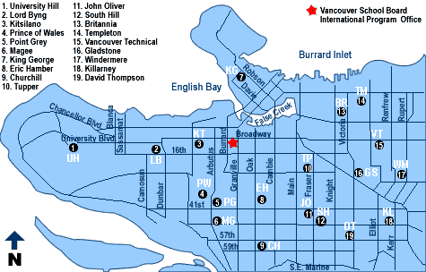
When can we use GIS? (Contd.)
Notes:
Question: What do the maps indicate or tell?

Slide 12
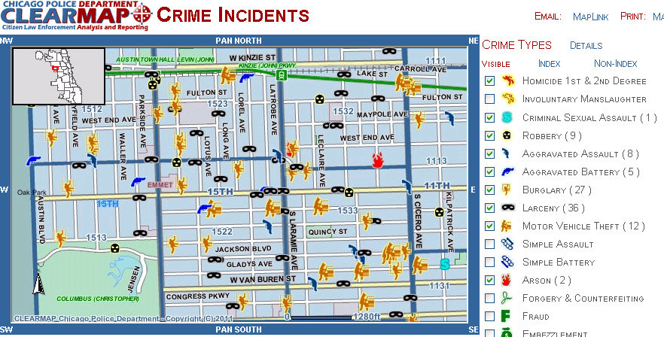
When can we use GIS? (Contd.)
Notes:
Question: What do the maps indicate or tell?

Slide 13
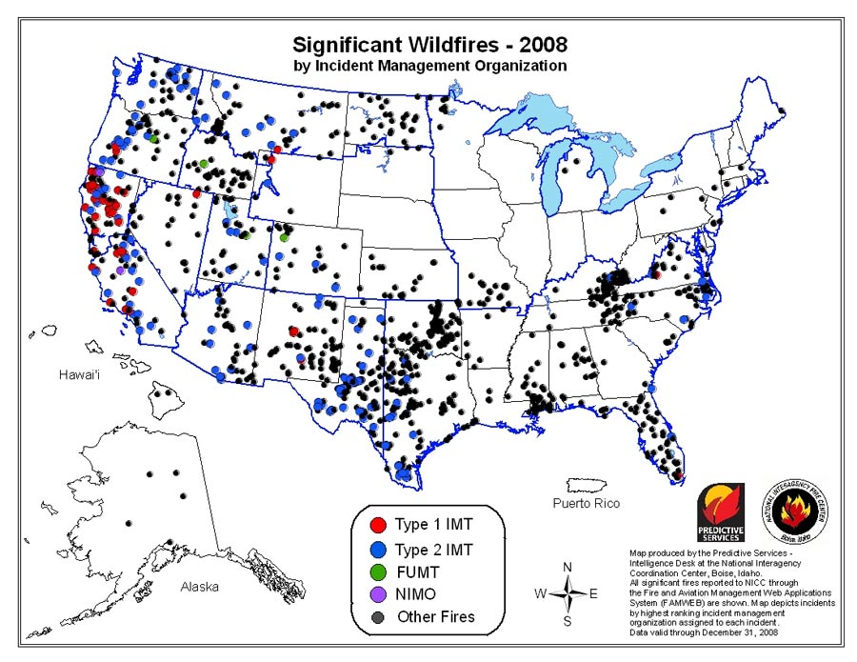
When can we use GIS? (Contd.)
Notes:
Question: What do the maps indicate or tell?

Slide 14
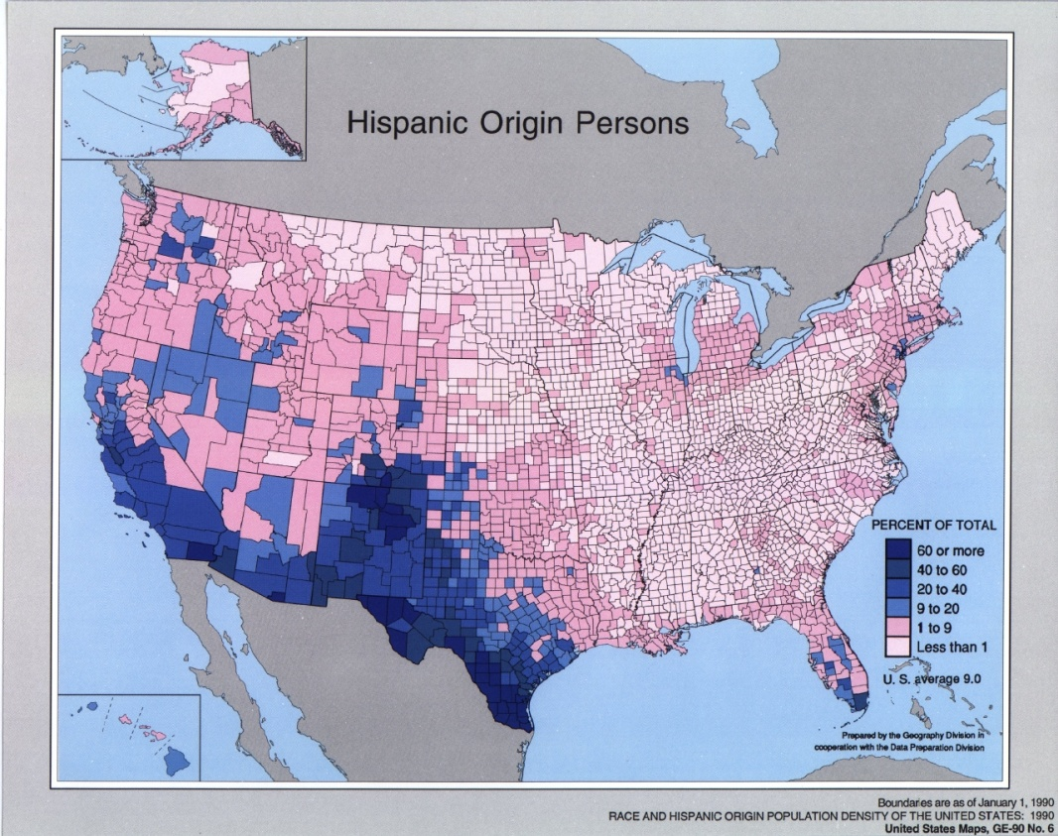
When can we use GIS? (Contd.)
Notes:
Question: What do the maps indicate or tell?

Slide 15

When can we use GIS? (Contd.)
Notes:
Question: What do the maps indicate or tell?

Slide 16
When can we use GIS?
To answer research questions –
What patterns exist?
Are features dispersed or clumped?
Are features of large, small, or
various sizes?
How is one feature distributed
relative to another?
What's obvious and what’s hidden

Slide 17
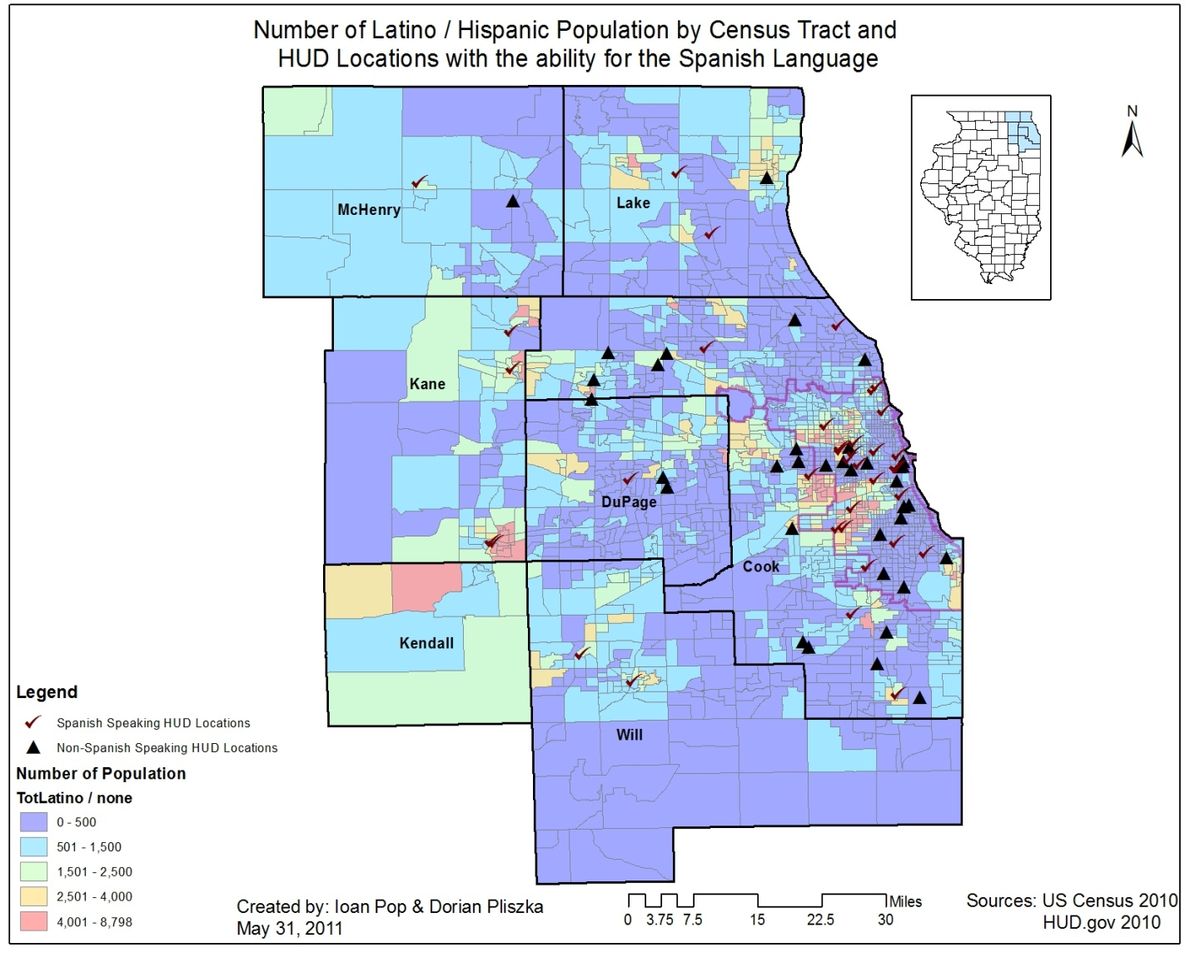
When can we use GIS?
To answer research questions –
2. Where is it? or what is at or near it?

Slide 18
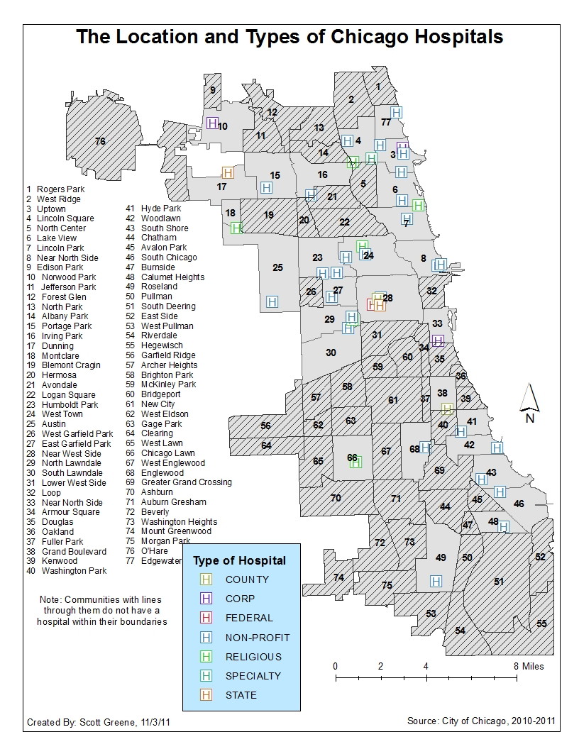
When can we use GIS?
To answer research questions –
3. What locations satisfy
certain conditions?

Slide 19
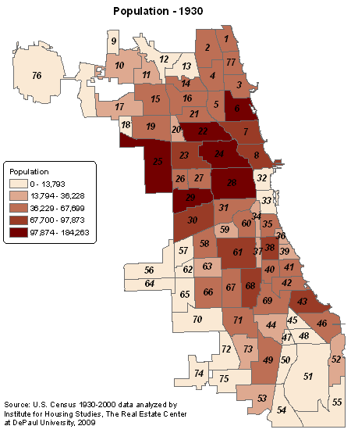
When can we use GIS?
To answer research
questions –
4. What trends exist?

Slide 20
Who uses GIS?
Everyone – general public to multimillion dollar companies and government
General Public
Non-profit organizations, CBOs, and NGOs
Education
Government
Public Safety
Transportation
Business

Slide 21

Who uses GIS?
General public Non-profit organizations, community based organizations and NGOs Health and Human Services - Academic Programs and Research - Hospitals and Health Systems - Human Services - Managed Care - Public Health Education - Libraries and Museums - Schools (K–12) - Universities and Community Colleges Government - Federal, State, Local - Civil Engineering - Economic Development - Elections - Land Administration - Public Works - Surveying - Urban and Regional Planning | Public Safety - Computer-Aided Dispatch - Emergency/Disaster Management - Fire, Rescue, and EMS - Homeland Security - Law Enforcement - Fire Management Transportation - Aviation - Highways - Logistics - Railways - Ports and Maritime - Public Transit Natural Resources - Agriculture - Climate Change - Conservation - Environmental Management - Forestry - Marine and Coast - Mining - Petroleum - Water Resources | Business - Banking and Financial Services - Facilities Management - Insurance - Media and Press - Real Estate - Retail Utilities and Communications - Electric - Gas - Location-Based Services - Pipeline - Telecommunications - Water/Wastewater Click here for more info.

Slide 22


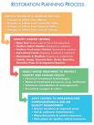
Components of GIS
People
Data
Software
Hardware
Procedure
Notes:
Data: Should be available and accurate otherwise the result will be affected
Procedure: should be well defined procedures for any analysis
Hardware: should be capable of handling the data volume and fast enough to run the process
Software: includes GIS and supporting S/W e.g. excel, statistical, imaging S/W
People: Most important component. People must define the procedure, collect the data, using the HW & SW carryout the analysis

Slide 23
Spatial and Non-spatial Data
GIS lets you use 2 types of data
  Spatial Data: describes a geographic location or refers to a location on the earth
    Example: Country, State, Zipcode
  Attribute Data (non-spatial data): specifies characteristics of spatial features
    Example: Population counts, unemployment percentage, type of housing units, magnitude of wildfires or earthquakes

Slide 24
Spatial and Non-spatial Data
Question: Which of the following are Spatial data?
  Chicago neighborhoods 7. City Wards
  Public school location 8. Wildfire locations
  School name 9. Building type
  School enrolment 10. Type of tree
  Illinois counties 11. Police station address
  Chicago police districts 12. Percent employed

Slide 25
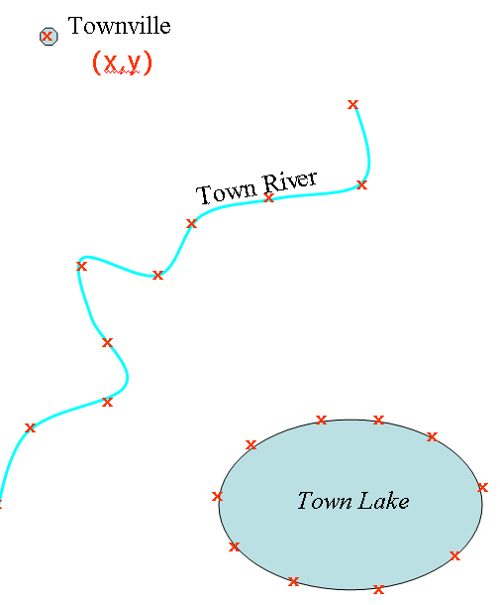
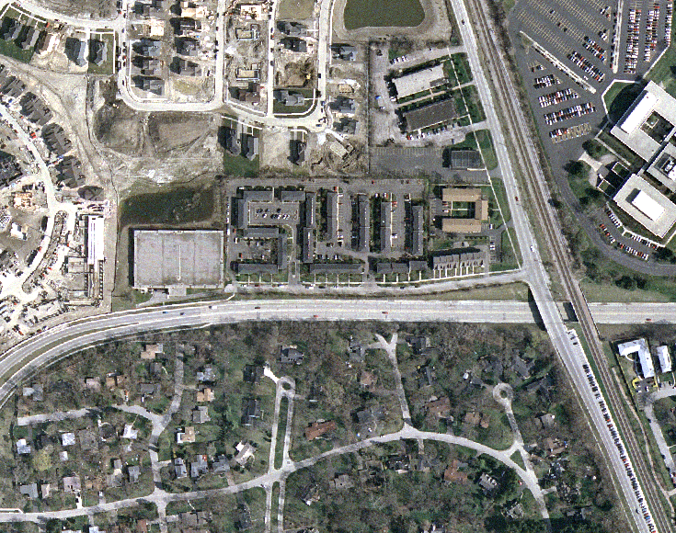
Spatial Data Models
Vector
Raster
Data is represented as point features, line features and polygon features
Data is represented using pixels
Notes:
GIS uses 2 types of data models – Vector and Raster

Slide 26
Spatial Data Models (Contd.)
Vector
Raster
Examples
  Points: Schools, fire houses, police stations, stop signs
  Lines: Roads, rivers
  Polygons: Country, state, county, zipcode, neighborhood
Examples
  Aerial images/photos
  Satellite images
Notes:
Questions: Name the vector layers - point, line polygon layers and the raster layer in the Landmarks map.
Trick Question: River that ends in a Pond; DPU’s LPC campus

Slide 27

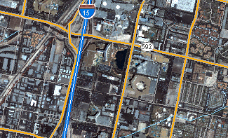
Spatial Data Models (Contd.)
Question: Out of the 2 images, which is vector, which is raster?
In the vector image, what types of features do you see – Point, Line, Polygon?
What is represented as Point?
What is represented as Line?
What is represented as Polygon?
Trick Question: Is this image vector or raster?
Notes:
Questions: Name the vector layers - point, line polygon layers and the raster layer in the Landmarks map.
Trick Question: River that ends in a Pond; DPU’s LPC campus

Slide 28
Types of Data Used in GIS
Types of Data
Spatial Data
Attribute Data
Spatial Data Models
Numeric
Non-numeric
Vector Data Model
Raster Data Model
Points
Lines
Polygons
Pixels
Notes:
To recap, the types of data, data models….

Slide 29
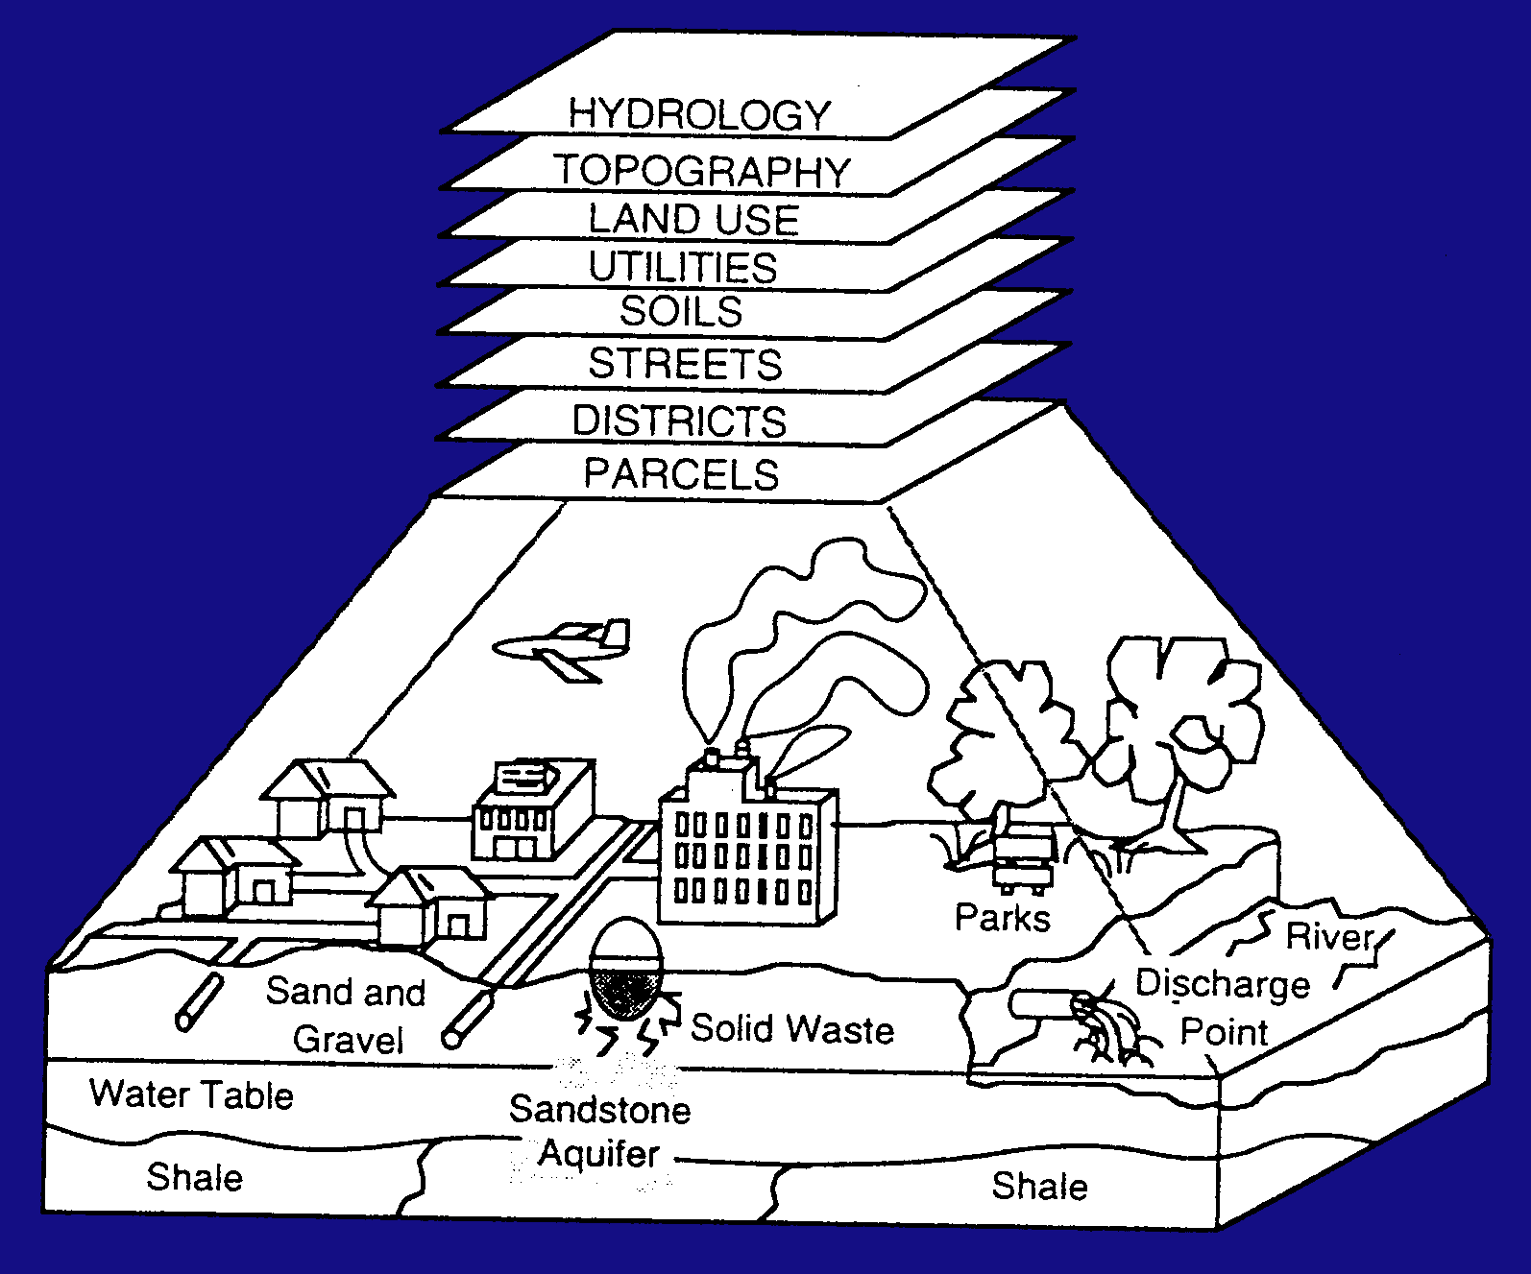
Vector Data
Vector data are organized into layers
Notes:
Layers could be added, manipulated and analyzed using the GIS application
Each one of the layers will be represented as a point, line or polygon.
Question: Could someone tell me what type of feature the streets layer will be converted to? A point, line or polygon?
How about Districts?
Utilities?

Slide 30
Using GIS Software for Mapping
What is ArcView, ArcEditor, ArcInfo?
  A software application used to analyze and display spatial data
Version of ArcInfo we will be using in class?
  Version 10
ArcView, ArcEditor, ArcInfo consists of 3 components:
  ArcMap: This lets you view, create, and query maps, as well as edit data.
  ArcCatalog: Provides data access and spatial data management tools, including the reading and creation of metadata.
  ArcToolbox: Consists of various functions that could be used for analysis, data management, statistical analysis etc.
Notes:
Now we will see how we could show the vector and raster data using our GIS application.
We use a GIS application called ArcView 9.3 to analyze and display our spatial data.
ArcView consists of 3 components ArcMap, ArcCatalog and ArcToolbox that could be seen when you open the application.

Slide 31
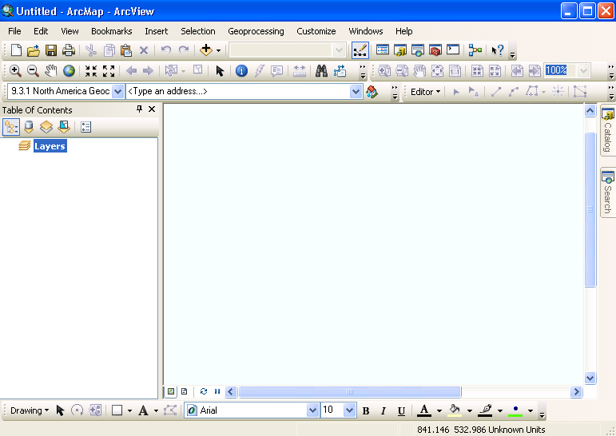
Using ArcInfo for GIS Mapping (Contd.)
ArcMap
ArcCatalog
ArcToolbox
Notes:
On your machines, open ArcMap. Once you open it, the screen should look like this.
ArcCatalog and ArcToolbox can be accessed via ArcMap.
We will be using ArcCatalog and ArcToolbox towards the end of the quarter

Slide 32
Using ArcInfo for GIS Mapping (Contd.)
Top Menu
Tools
Map Area
Table of Content
Layout View
Data View
Refresh
Formatting Tools
Notes:
On your machines, open ArcMap. Once you open it, the screen should look like this.
ArcCatalog and ArcToolbox can be accessed via ArcMap.
We will be using ArcCatalog and ArcToolbox towards the end of the quarter

Slide 33
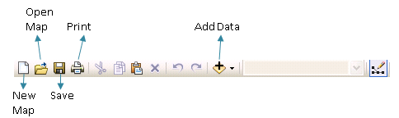
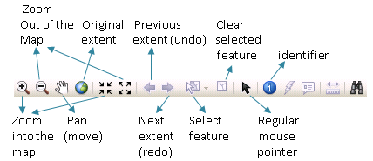
Using ArcInfo for GIS Mapping (Contd.)
Tools
Notes:
On this screen, you will see a number of icons on the top of the screen.

Slide 34
Lab 1
Use ArcMap
Examine tools
Examine feature layers
Create a simple map using vector and raster data
Notes:
Lab:
What to do if the map disappears?
What to do if I cant locate my shapefiles?
I saved files on the desktop, but my machine crashed and I cant find my map

Slide 35
Next Week (Week 2)
Assignment 1 due Friday midnight

