Slide 1
GEO 241: Geographic Information Systems I
Week 2: Cartography and Map Design

Slide 2
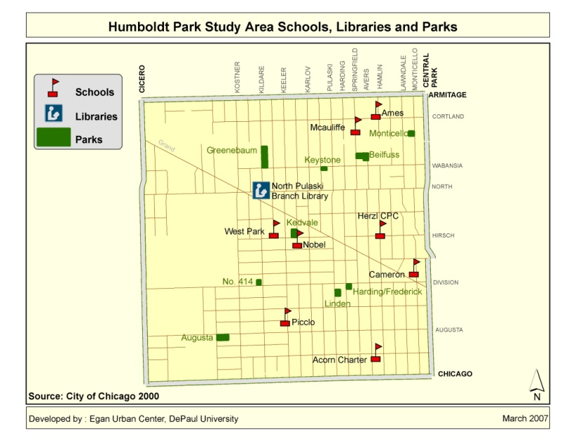
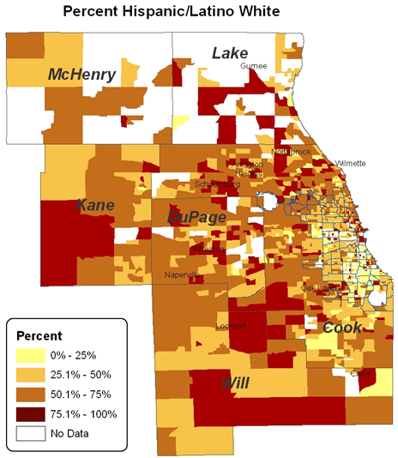
Type of Maps
General maps
Shows location and positions
E.g. Locations of Schools, libraries and parks
Thematic maps
Distribution or concentrations of attributes
E.g. Population change, racial concentrations

Slide 3
Type of Maps
General maps
Map types
Single symbol / featured
Unique value
Thematic maps
Map types
Graduated color / choropleth
Graduated symbol / proportional Symbol
Dot density
Charts

Slide 4
Single Symbol / Featured Map
Emphasis is on location
All data is at the same level of importance
All the features in the theme are displayed with the same colors and symbols
This is useful when you only need to show where a theme’s features are located (not based on field value)
Example:
Notes:
Emphasis is on location
Same level of importance
Same colors

Slide 5
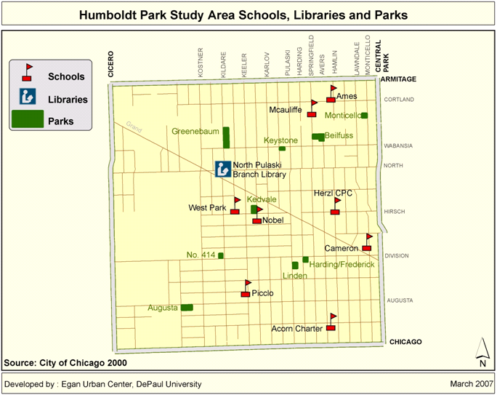
Single Symbol / Featured Map - Example
Notes:
Emphasis is on location
Same level of importance
Same colors

Slide 6
Graduated Color / Choropleth Map
All Features are displayed with the same symbol type, but the colors represent the progression of values for a data attribute you specify
Example:

Slide 7
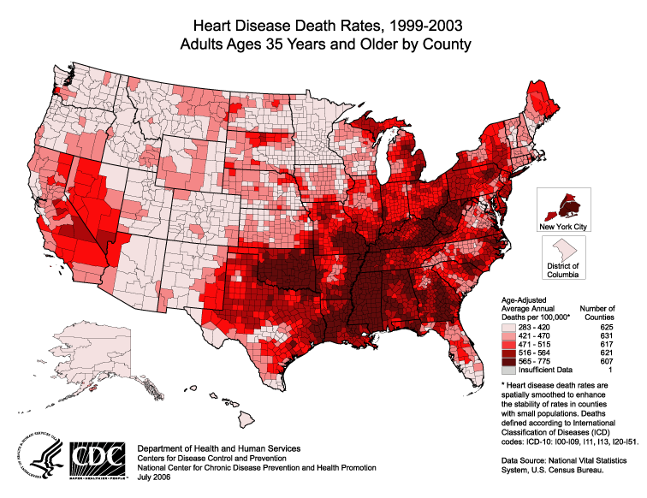
Graduated Color / Choropleth Map - Example

Slide 8
Graduated Symbol / Proportional Symbol Map
The features are displayed with the same type and colors, but size of symbols represent progression of values.
This is the best way to symbolize data that expresses size or magnitude.
Example:

Slide 9
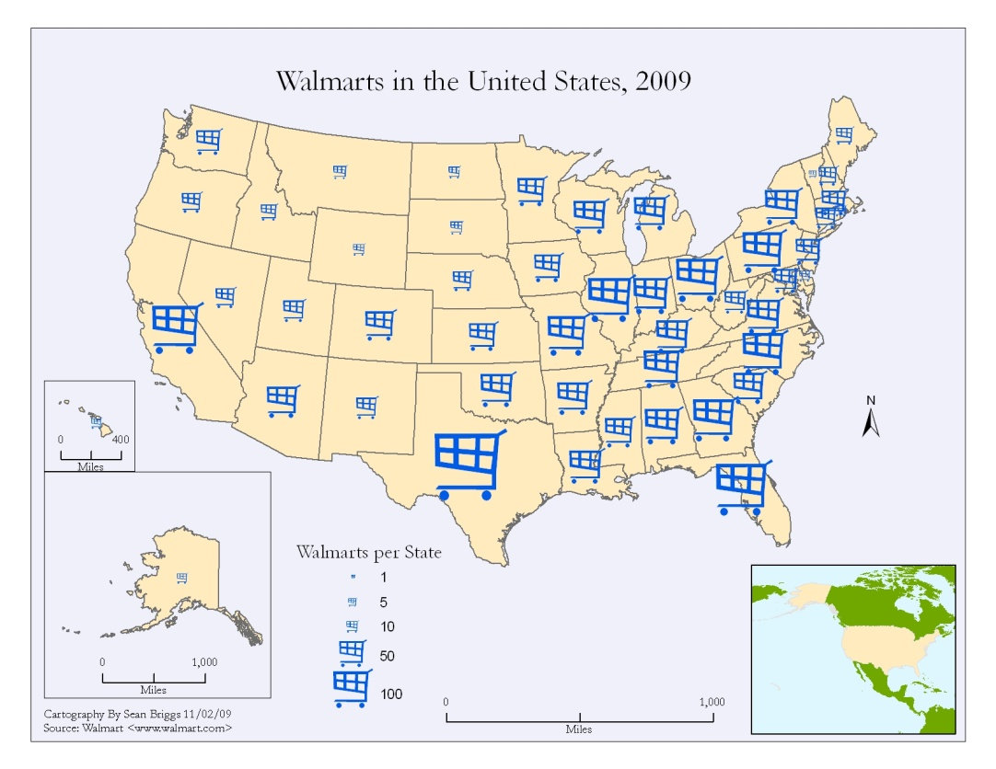
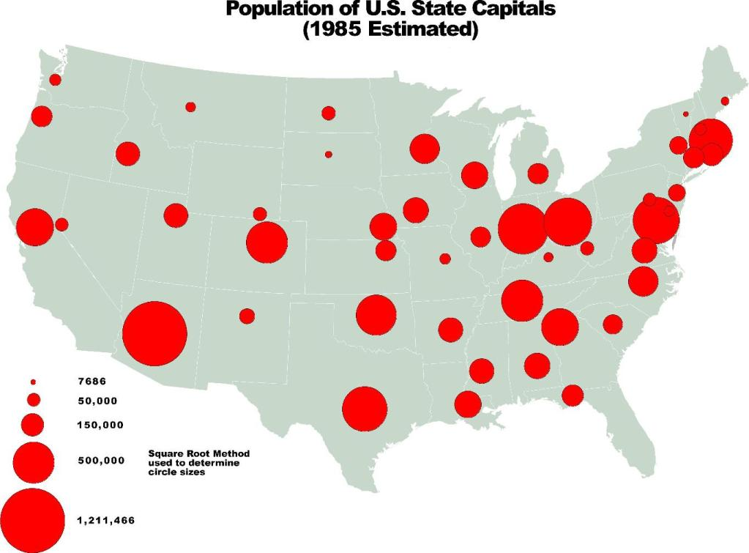
Graduated Symbol / Proportional Symbol Map - Example

Slide 10
Unique Value Map
Each unique value in a theme is represented with a unique symbol or color
Example:

Slide 11
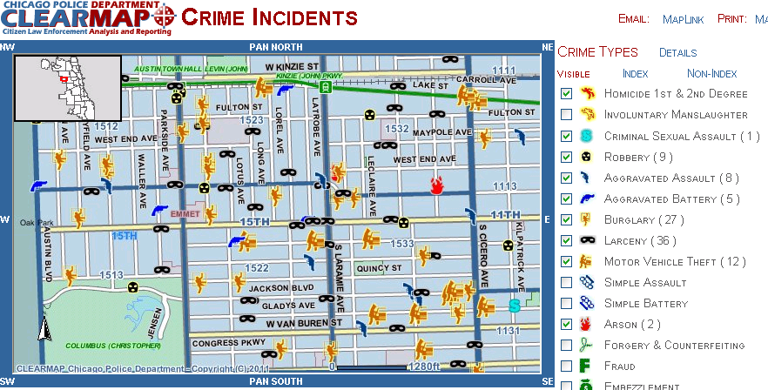
Unique Value Map - Example

Slide 12
Dot Density Map
Each dot represents certain amount of a phenomenon or feature
Dots placed at location where it is likely to occur
Example:

Slide 13
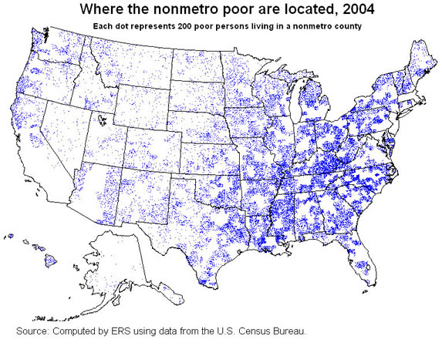
Dot Density Map - Example

Slide 14
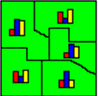
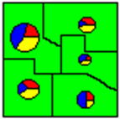
Charts Map
The features are displayed with a chart
The components of the chart correspond to data attributes you specify. The size of each part in a chart is determined by the value of each data attribute
You can specify whether the charts are pie charts or column charts
This is a good method for displaying the values of many attributes
Example:
White
White
Black
Black
Other
Other

Slide 15
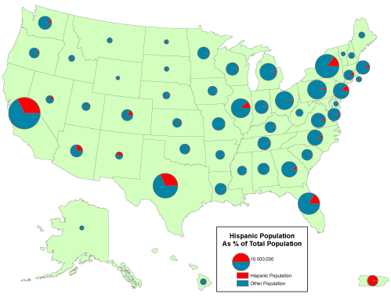
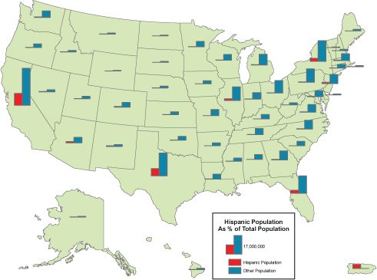
Charts Map - Example

Slide 16
Deciding which type of map to use?
Maps could be created with
Spatial data (to show locations)
Non-spatial or Attribute data (to show characteristics)
Numeric
Text
Notes:
Most often we combine spatial data with non-spatial data to create maps.
E.g. Show attribute table.

Slide 17
Deciding which type of map to use?
Type of Variable | Type of map to use
To show only the locations e.g locations of Schools, Stations, Parks | Single Symbol or Featured (Single symbol/featured is not dependant on variable or its value)
Text e.g. Building Status | Unique value
One Number variable (Integer or Decimal) e.g. Population | Graduated color / choropleth, Graduated / proportional Symbol, Dot density
Two Number variables, both are related e.g. White & Black; Male, Female | Charts
Two Number variables, both not related e.g. Population and Median Income | One variable represented as Graduated color & the other as Graduated Symbol (Overlay both layers)

Slide 18
Deciding which map type to use? (Contd.)
Which map type will you use to represent the
following data? (i.e. Graduated color, Graduated Proportional
Symbol, Charts, Single symbol/featured, Unique value).
Traffic Stop Locations
Population
Income
Number of Males and Females
Race: # of Whites, # of Blacks
Crime Rate
Population and Income
Population and Males & Females
Notes:
Spatial data – Single symbol
Attribute data – rest of the map types
Determine if it is spatial or non-spatial. If non-spatial, determine if the data is numeric or non numeric. Then identify which map type can be used.

Slide 19
Map Design: What you should know
Number of features displayed
“Too many features are too much, too little features isn't enough”
Rules of Thumb
Find a balance that portrays enough information without making the map appear cluttered or busy.
Show the necessary features along with enough supporting features for clarity.
Notes:
We learnt what types of maps can be created, now we will look at some map design issues that you may encounter
TO many features, too hard to read and understand. Will give you a headache.
Keep it simple, and fewer features.
If necessary split the map to several little maps.

Slide 20
Map Design: What you should know
(2) Map elements
Title: Map title
Legend: Key to read the map. e.g. red lines represent streets, yellow dots represent schools
Source: Date and place the original data was obtained. e.g. U.S. Census 1990-2000
Author: Creator of the map
Date: Date the map was created
Scale: Map scale is the ratio of the distance on the map to corresponding distance on the ground
North arrow: Indicates where north is
Labels: Label features

Slide 21
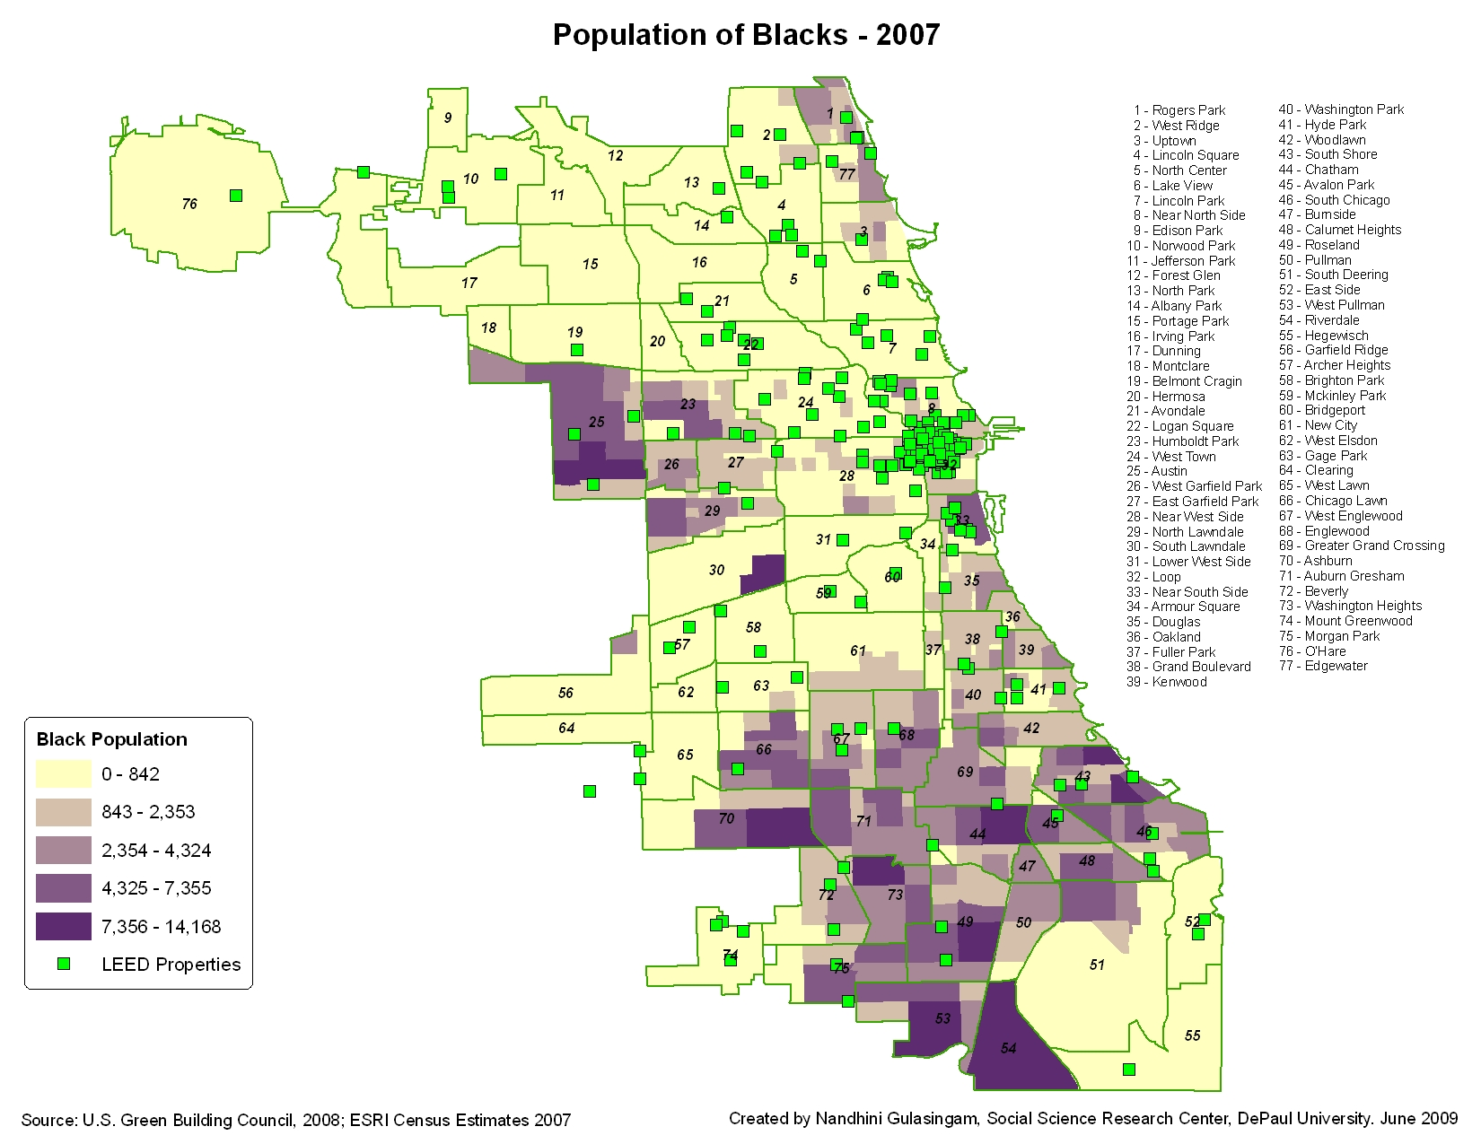
Map Design: What you should know
Title
Label
Legend
North arrow
Scale
Author
&
Date
Source

Slide 22
Map Design: What you should know (Contd.)
(3) Colors
Colors are very important
Everyone sees colors differently
Visual color limitations
Perception of colors
Reds/shades of reds – Warning
Blue – Water
Green – Open land, park
Purpose and use of the map will determine color selection
Book printed in B&W
Poster or flyer printed in color
Report that will be copied using B&W printer

Slide 23
Map Design: What you should know (Contd.)
(4) Symbols
Perception of symbols
E.g. School or Golf course?
Murder Locations? or

Slide 24
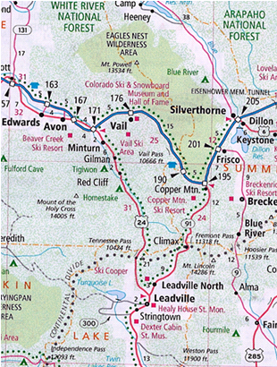
Map Design: What you should know (Contd.)
(5) Text
Style, size, weight, form and placement of text is important
Should be legible
Use capital and simple case
Shouldn’t be too many
Make sure to label by geography or name

Slide 25
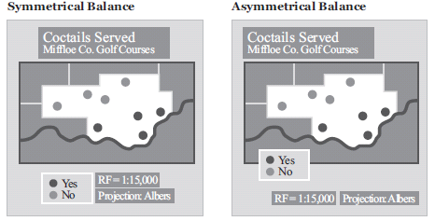
Map Design: What you should know (Contd.)
(6) Visual balance
Poor balance = distracts map readers
Good balance = helps focus on content of the map

Slide 26
Map Design: What you should know (Contd.)
(7) Visual Hierarchy
Titles
Subtitles
Main map
Large scale map showing details
Legends
North arrow, scale bar
Explanatory text notes , source, label

Slide 27
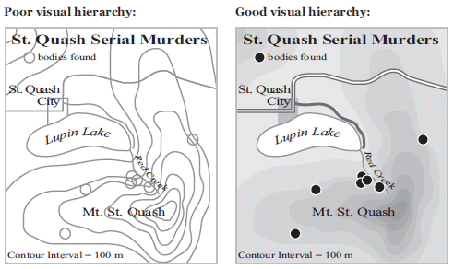
Map Design: What you should know (Contd.)
(7) Visual Hierarchy – within the map
Successful visual hierarchy
= shows what's most important first (jumps out)
= less important elements are less noticeable
Notes:
Different elements on and around it influences the look and feel of the map

Slide 28
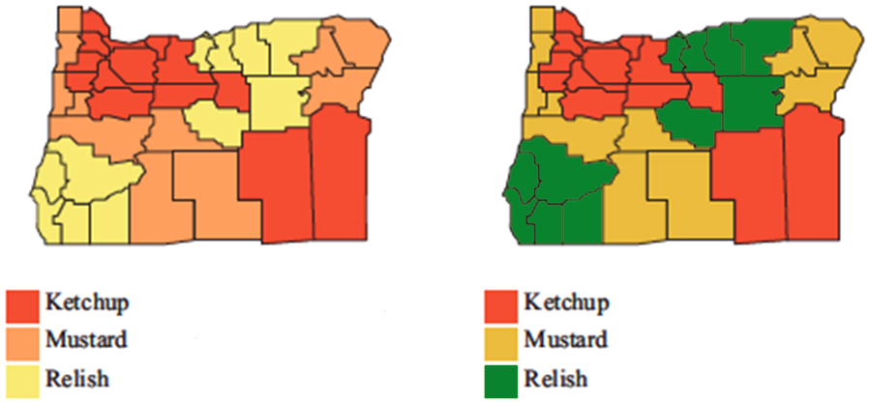
Map Design: What you should know (Contd.)
Which map looks better? Why?

Slide 29
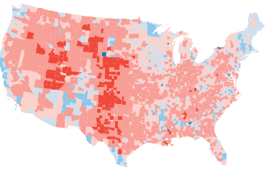
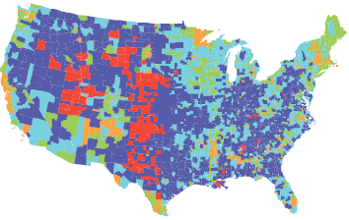
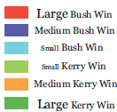
Map Design: What you should know (Contd.)
Which map is more appropriate? Why?
Notes:
Picking colors – easy to relate to; shouldn’t have to go back and forth to the legend to see what it corresponds to

Slide 30
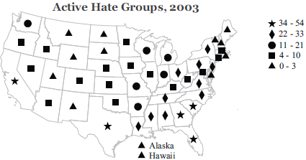
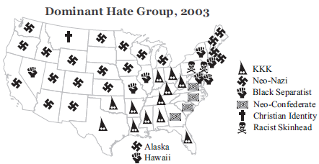
Map Design: What you should know (Contd.)
Which map looks better? Why?
Can this map be recreated using another type of map? What? Why?

Slide 31
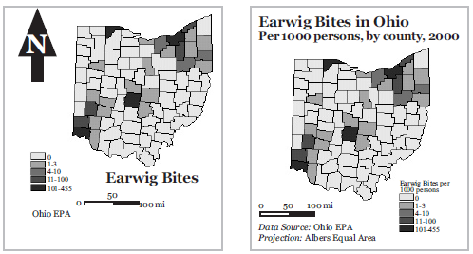
Map Design: What you should know (Contd.)
Which map looks better? Why?
Notes:
Is the 2nd map missing anything? What?

Slide 32
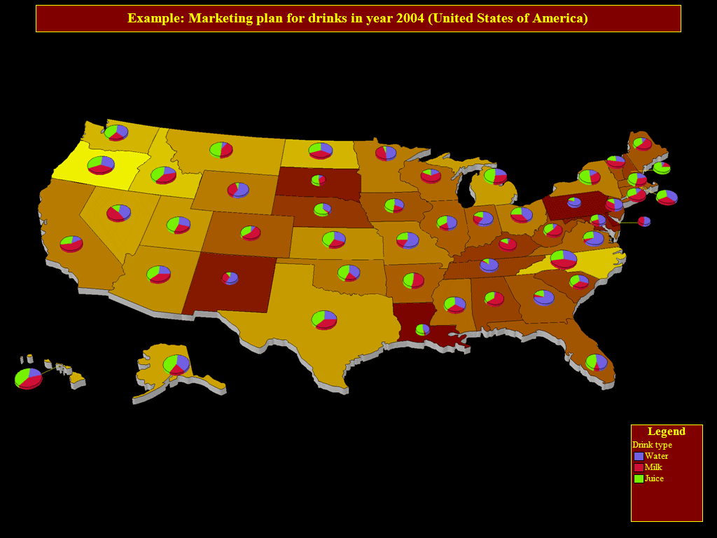
Map Design: What you should know (Contd.)
Is there a problem with this map? Why?
Notes:
Is the 2nd map missing anything? What?

Slide 33
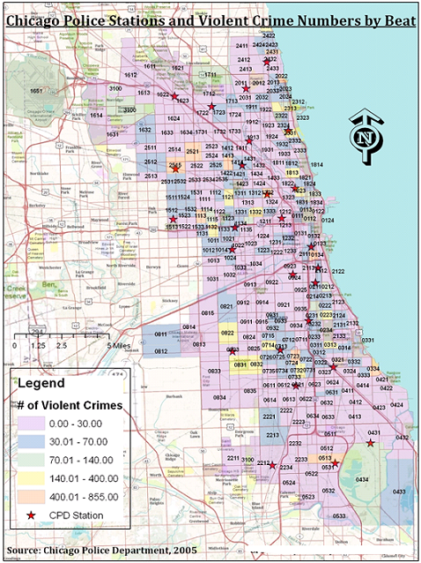
Map Design: What you should know (Contd.)
What do you think
of this map?
Notes:
Is the 2nd map missing anything? What?

Slide 34
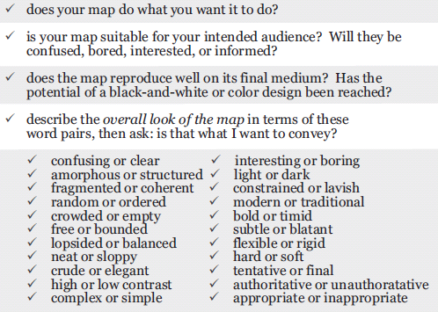
Map Design: What you should know (Contd.)
Checklist for map design
Source: http://makingmaps.owu.edu/mm/MakingMapsCh12.pdf
Notes:
Is the 2nd map missing anything? What?

Slide 35
Factors Controlling Map Design
(1) Map Medium
Where is this going to be used?
Book
Wall
Flyer
Poster
Website
How it is going to be used?
Black & white Vs color
Notes:
Several factors can limit your creativity and flexibility in designing a map
Map medium will determine, the amount of information, colors, size, image resolution that could be displayed

Slide 36
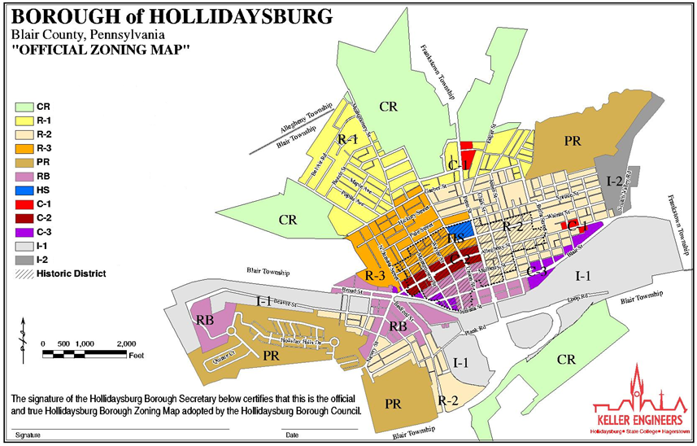
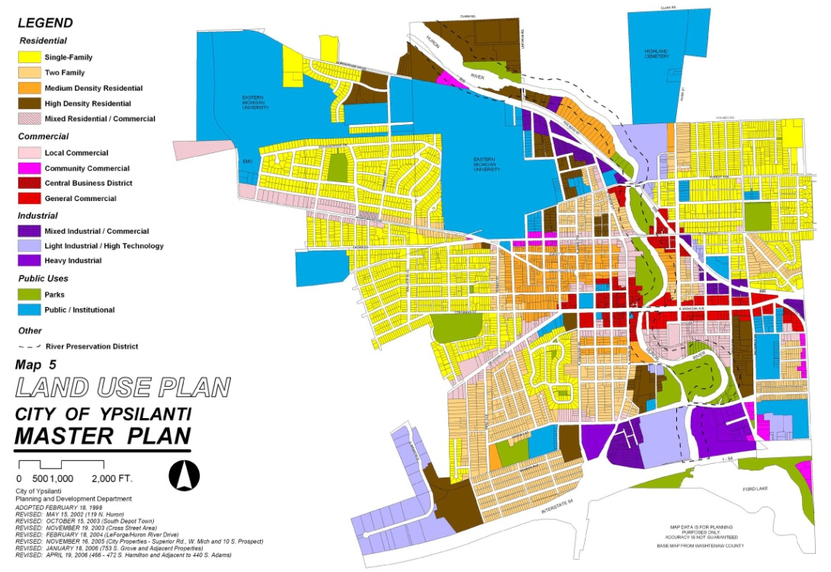
Factors Controlling Map Design (Contd.)
(2) Audience
Complexity and level of audience e.g. technical committee or general public
Notes:
Several factors can limit your creativity and flexibility in designing a map

Slide 37
Factors Controlling Map Design (Contd.)
(3) Technical Limitations
Availability of data
Proficiency of staff
Amount of detail that can be shown on a limited size paper
Quality of map on screen vs printed map
Notes:
Several factors can limit your creativity and flexibility in designing a map

Slide 38
Map Layout and Design
Things to remember while designing map
layout and map design
The best data or analysis in the world will have a hard time being effective if it can't be presented effectively
Every map should tell a story
Everything you select/add to the map should have a meaning and a purpose
Use the space effectively
Focus should be on the main map
Follow the KISS principal (Keep It Simple Stupid)
Notes:
Several factors can limit your creativity and flexibility in designing a map

Slide 39
Lab 2
Create various types of maps
Add map elements
Format legend labels
Incorporate map design principles

Slide 40
Next Week (Week 3) – IMPORTANT!!!
Assignment 2 due Friday at midnight

