Slide 1
GEO 241: Geographic Information Systems I
Week 3: Cartographic Principles: Classifications
Coordinate Systems
Map Projections

Slide 2
Classification
Used for quantitative (numeric) data
Classification places attribute values into groups
Two key factors for classifying your data:
1. Classification type
e.g. Natural breaks, manual breaks, standard deviation
2. Number of classes
e.g. class size of 4 or 5

Slide 3
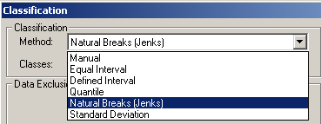
Classification
Classification types :
Most commonly used classifications
Natural Breaks (Default)
Manual
Standard Deviation
- Natural Breaks (Default)
Manual
Standard Deviation
- Equal Interval
- Defined Interval
- Quantile
Geometrical interval

Slide 4
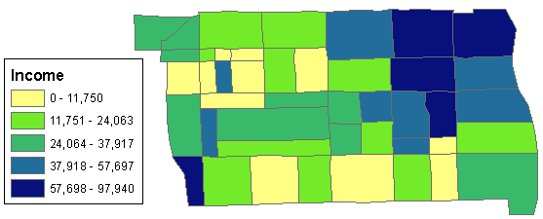
Classification
Terminology
# of Classes : 5
Class interval : Class boundary. The lower and upper limits

Slide 5
Classification
Classification types : Natural breaks (Jenks)
Default Method
Classes are based on natural groupings
Good for
mapping data values that are not evenly distributed because it places cluster values in the same class
Data that you are not familiar with (to identify clusters)

Slide 6
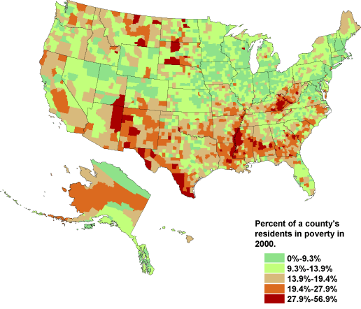
Classification

Slide 7
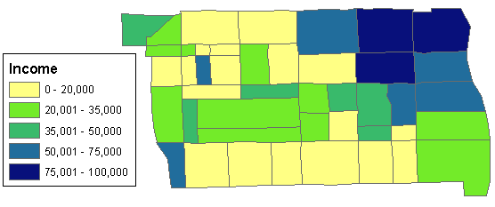
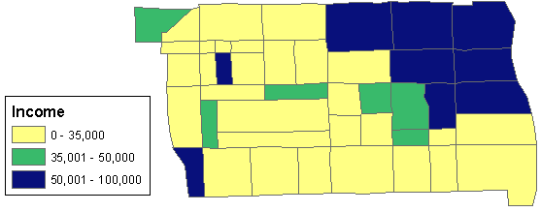
Classification
Classification types : Manual breaks
Classification scheme where you specify your own class intervals
Comparing features to specific, meaningful values
Manually specify the upper and lower limit for each class
You may also manually classify data to emphasize a particular range of values, such as those above or below a threshold value.
Manually specify upper/lower limits
Emphasize ranges – Low, moderate, high income levels

Slide 8
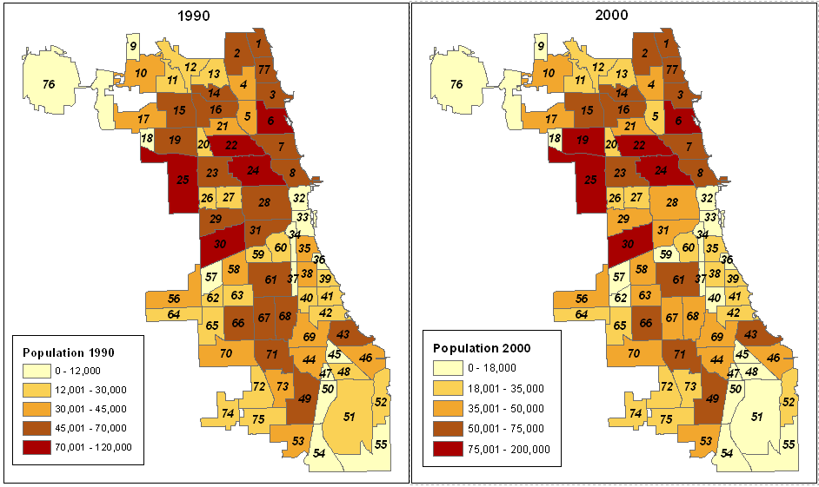
Classification
Can we compare these two maps? Why / Why not?

Slide 9
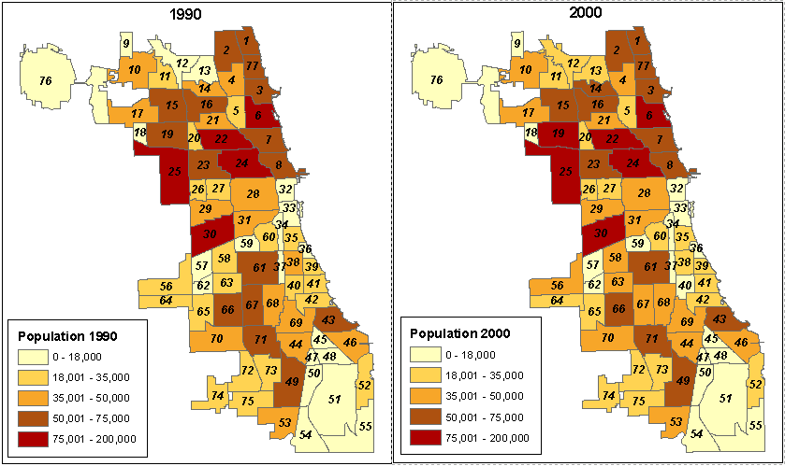
Classification
Ans: The class ranges and # of class should match, use manual breaks
to modify the ranges

Slide 10
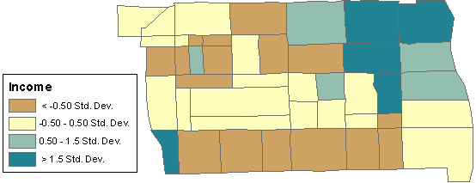
Classification
Classification types : Standard deviation
Shows distribution above and below the mean
Good to locate atypical values
Useful to map the deviation from the norm e.g. crime, disease
It doesn’t show the actual value of the features, only how far their value is from the mean

Slide 11
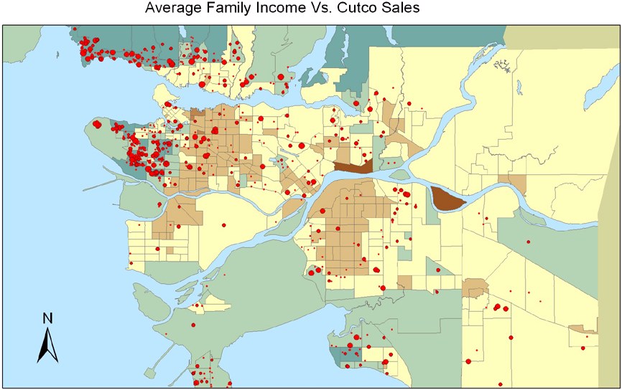
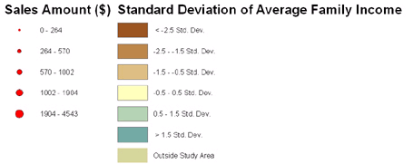
Classification

Slide 12
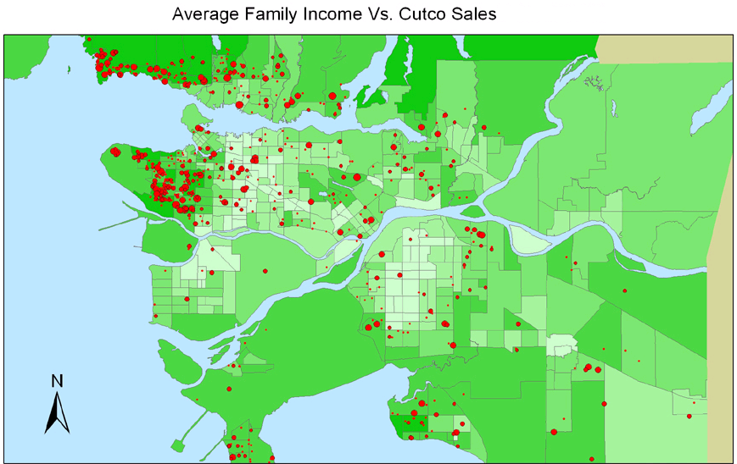
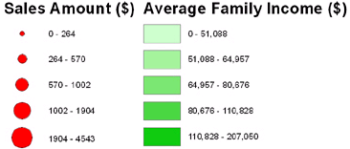
Classification

Slide 13
Classification
Few things to remember about classification
How you choose to define class ranges and breaks will determine which features fall into which class
By changing the class and/or ranges, you can create maps that look different even though you use the same data
Generally, the goal is to make sure that features with similar values are in the same class
Where do you specify classification in ArcMap?
Under Symbology → Quantities → Classify (button) → pick the classification type

Slide 14
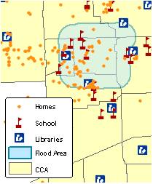
Cartographic Principles: Georeferencing
What is Georeferencing?
In GIS, data is referenced to a location on the earth’s surface
When representing real-world features, you need to reference data to the correct location
The process of linking data to the physical location is known as georeferencing

Slide 15
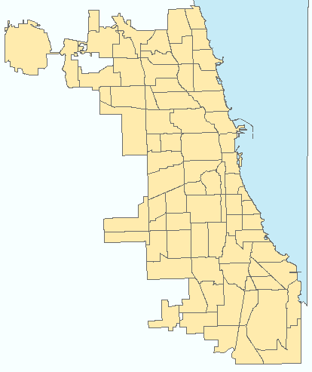
Cartographic Principles: Georeferencing
Chicago Public School (CPS) Locations
Data located correctly, size/shape not distorted
Data located incorrectly
CCA shape & size distorted

Slide 16
Cartographic Principles: Georeferencing
Why Georeferencing?
If data is not located correctly, or if their shape or size is distorted, then your mapping and spatial analysis will yield incorrect results
So, without properly "georeferencing" all your GIS data to a standard coordinate and projection system, your data will essentially be useless!
Coordinate Systems and Map Projections are the most crucial concepts to grasp
Georeferencing is accomplished using Coordinate System and Map Projections

Slide 17
Cartographic Principles: Coordinates & Map Projections
Coordinate Systems:
Why do we need a coordinate systems?
GIS layers having different coordinate systems will not overlay properly on top of one another
GIS data need to be located properly in geographic space in order to be used in mapping and spatial analysis
Coordinate systems are used to reference the features on a map to the actual locations of the objects they represent on the surface of the earth

Slide 18
Cartographic Principles: Coordinates & Map Projections (Contd.)
Coordinate Systems:
Coordinate systems can be represented in two ways:
1. Geographic coordinate system: A measurement of a
location on the earth's surface expressed in degrees of
latitude and longitude
2. Projected coordinate system: A measurement of
locations on the earth's surface expressed in a two-
dimensional system. It locates features using x
(horizontal) and y (vertical) axis

Slide 19
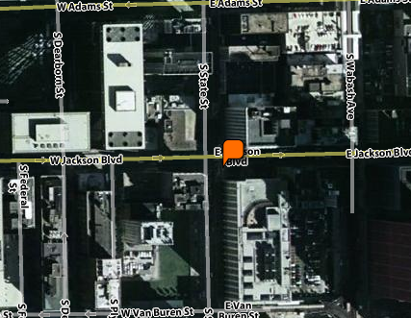
Cartographic Principles: Coordinates & Map Projections (Contd.)
Coordinate Systems:
Example: Lat/Long and X/Y coordinates for 1 E Jackson Blvd, Chicago, IL
Geographic Coordinates |  | Projected Coordinates
Longitude | -87° 37' 38.0172" | X | -87.627227
Latitude | 41° 52' 39.0432" | Y | 41.877512
Latitude / Y
Longitude / X

Slide 20
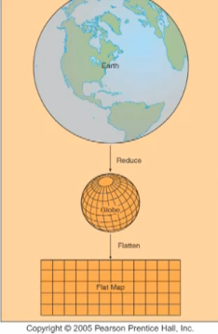
Cartographic Principles: Coordinates & Map Projections (Contd.)
Map Projections:
The spherical surface (3D) of the earth is shown on flat maps with the help of projections.
The earth is reduced to the size of a globe with the scale equal to the desired flat map. All spatial properties are true to those on the earth.
Then the globe is flattened. Since this cannot be done without distortion, certain spatial properties are preserved.
Spatial properties include area, shape/angel, distance or direction

Slide 21
Cartographic Principles: Coordinates & Map Projections (Contd.)
Map Projections:
When transforming the features/data from a 3D globe to a 2D flat planar map spatial distortion occurs
These distortions can be either area, shape, distance or angle
Map projection is used to preserve these distortions
Map projections can preserve only one property
Area (Equivalent)
Angle / Shape (Conformal)
Distance (Equidistant)
Direction (Azimuthal)

Slide 22
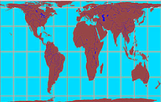
Cartographic Principles: Coordinates & Map Projections (Contd.)
Map Projections: Types
(1) Equal Area
Preserves area
Many thematic maps that need area to be preserved uses this projection
e.g. of projection type: Peters
When should you use equal area projections?
Population per square mile area
Pollution/deforestation
Crop yielding
Greenhouse warming
Peters

Slide 23
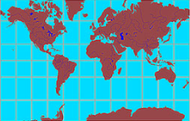
Cartographic Principles: Coordinates & Map Projections (Contd.)
Map Projections: Types
(2) Conformal:
Preserves shape and angle
Shape is preserved only for small areas
e.g. of projection types: Lambert, Mercator
When should you use conformal projections?
Navigational charts
Weather maps
Mercator

Slide 24
Cartographic Principles: Coordinates & Map Projections (Contd.)
Map Projections: Types
(3) Equidistant:
Preserves distances
Useful to find features that are within a certain distance of other features
When should you use equidistant projections?
Environmental (e.g. distance from oil spill to affected areas)
To show air-route distances

Slide 25
Cartographic Principles: Coordinates & Map Projections (Contd.)
Map Projections:
(4) Azimuthal
Preserves direction
This can be combined with equal area, conformal, and equidistant projections
e.g. of projection types: Lambert Equal Area Azimuthal and the Azimuthal Equidistant projections
When should you use azimuthal projections?
navigation (air, land, water)

Slide 26
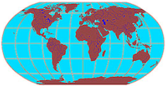
Cartographic Principles: Coordinates & Map Projections (Contd.)
Map Projections:
(5) Other
e.g. of projection type: Robinson. It is neither equal area nor conformal but is aesthetically pleasing and useful for general mapping
Where do you see these? Most commercially created world maps

Slide 27
Cartographic Principles: Coordinates & Map Projections (Contd.)
Map Projections:
How to decide what type of map projection to use?
Use / purpose of map
Scale or area to be shown
Property that is critical to preserve

Slide 28
Lab 3
Experiment with different types of classification methods, and map projections
Select the best classification type and map projection
Interpret the maps

Slide 29
Next Week (Week 4)
Assignment 3 due Friday midnight

