Slide 1
GEO 241: Geographic Information Systems I
Week 4: Data Creation – Spatial and Attribute Data
Using Field Calculator
Joins – Join Attribute Data

Slide 2
Next Week (Week 5) – IMPORTANT!!!
Midterm Exam
- Theory & Practical
- 2 ½ hours
- Whatever we have covered so far from day 1
- Open book
Assignment 4 due Week 6 (Oct 12), but completing it before the Midterm will be helpful

Slide 3
Creating Data
To create a map you will need
Spatial data:
Shapefile that includes the shape, boundary or location
Attribute data:
Attributes, values or characteristics of the shape, boundary or location

Slide 4
Creating Data
Methods of creating data (partial list)
Attribute data:
Joining*
Manual data entry*
Field calculator
Spatial data:
Digitizing*
Selecting and exporting (subsets)
Geocoding
Buffers
* Will learn today

Slide 5
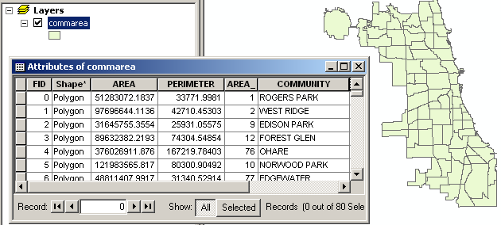
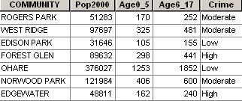
Creating Attribute Data
Attribute data contains details of the characteristics of the shape
Spatial data contains details of the shape

Slide 6
Creating Attribute Data
Why?
Most spatial data do not include attribute data
Spatial data and attribute data come as separate files
Attribute data needs to be joined with spatial data to create maps
Attribute data can be combined with spatial data by
Manually entering
Joining

Slide 7
Few things about Attribute Data
Attribute data is typically stored in tables that are linked/associated with the spatial data
This allows us to
Search/retrieve data based on a criteria
Perform analysis

Slide 8
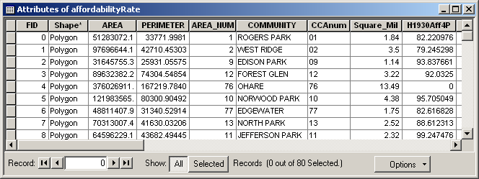
Database Terminology
Field Name
Column
Row
Table
Value
Total # of records
Table: Consists of rows and columns
Row = Record
Columns = Filed
Value = Cell (Values are case sensitive)
Field Name = Variable

Slide 9
Database Concepts
Data Types
Data type is a way of classifying your data. i.e. it indicates what type of data it contains
E.g. Text, Number, Date, Binary, Image

Slide 10
Database Concepts
Data Types
Numeric: Numeric fields can be stored as one of four
numeric data types
Short Integer
Long Integer
Float
Double
Whole Numbers
Decimal Numbers

Slide 11
Database Concepts
Data Types
Numeric:
(i) Short integer –
Saves values between -32,000 and +32,000
Whole numbers OLNY
e.g. Number of students in a class – 50
Age – 16
Year of house built - 1996

Slide 12
Database Concepts
Data Types…
Numeric:
(ii) Long integer -
Saves values between -2 billion and +2 billion
Whole numbers OLNY
e.g. Total population - 234500
Income – 45000

Slide 13
Database Concepts
Data Types…
Numeric:
(iii) Float –
Saves values between -32,000 and +32,000
Saves decimal values.
e.g. Percent unemployed – 23.76
(iv) Double-
Saves values between -2 billion and +2 billion
Saves decimal values.
e.g. Average Income – 400000.56

Slide 14
Database Concepts
Data Types…
(2) Text:
Stores alphanumeric characters and special characters
e.g. Address - 234 S. Wabash Apt# 2B
(3) Date:
Stores date and time data
e.g. Building permit issued date – 10-20-1990

Slide 15
Database Concepts
What data type should be used to store the
following info?
Community Area Name 6. Zipcode
Population 7. Percent Change
Median Income 8. Square Miles
Percent Unemployed 9. Area
Building Status 10. GPA

Slide 16
Database Concepts
What data type will you use for the following data?
Population | DistrictNo | CrimeRate | AvgIncome | AvgHHSize
100000 | 01 | 34.5 | 50000.50 | 5
234567 | 02 | 45.1 | 1000000 | 4
78945356 | 03 | 2.5 | 23446.50 | 6
345687 | 04 | 6.8 | 345000 | 4

Slide 17
Database Concepts
Creating Field Names
Things to remember when creating Field Names
Should start with a character
Can have character, number or underscore
Cannot exceed 10 characters
Cannot contain special characters other than underscore
Valid filed names: Pop2000, MedInc90, PctEmp, Bld_Type
Invalid field names: %unemp, percentUnemployed, 90_bldType, Type&Score

Slide 18
Database Concepts
Which field names are invalid? Why?
1. Population 2000
2. Pop 2000
3. Pop_2000
4. 2000_Population
5. Pop_2000%
6. Population_2000

Slide 19
Creating Attribute Data
Methods
(1) Manual entry
(2) Joining

Slide 20
Creating Attribute Data- Manual
(1) Manual Entry
Why?
Add new attribute data
Change existing data
When?
Sometimes it is easier to make a small change
Enter a few values manually
How?
Create a field (Use the correct naming convention)
Select Data Type (Select correct data type for the variable)
Enter data in edit mode
Save the data

Slide 21
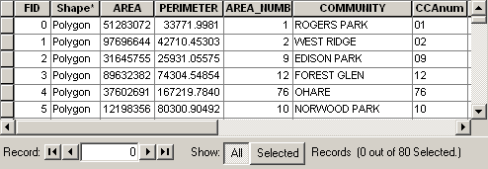
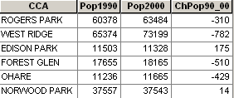
Creating Attribute Data- Join
(2) Joining
Why?
Spatial and non-spatial data come in separate files
Attribute data formats: Excel, .dbf, .csv, access, database, PDF, etc.
It is easier to join the attribute data than re-entering
Spatial Data
Attribute Data
Includes only the attribute
data for CCA. Doesn’t include
the boundary info.
Includes only the boundary data for
the Chicago Community Areas (CCA)

Slide 22
Creating Attribute Data- Join
How? (Rules)
Spatial data (Shapefile) and the attribute data should have a common field
The field name does not have to be the same, but the data type has to be the same. i.e. you join numbers to numbers, text to text, and so on.
Values of the two matching fields have to be the same

Slide 23
Creating Attribute Data- Join
When the join is performed, the 2 separate tables become one containing the information from both tables
The join is a temporary relationship and may be removed when it is no longer needed.

Slide 24
Creating Attribute Data- Join
Question: Which fields will you use to join the 2 tables?

Slide 25
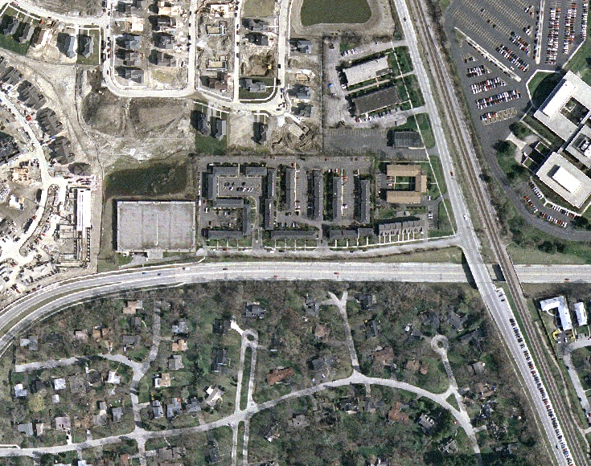
Creating Spatial Data - Digitizing
What?
A process of converting features of a paper map or an image to a digital format
Trace the boundary or shape to create a new shapefile
Example:

Slide 26
Creating Spatial Data - Digitizing
Why?
Create spatial data
Not always readily available
Unobtainable
Too expensive
Modify spatial data
Add new features to the existing shapefile
E.g. New Schools are added to the CPS school point shapefile
Modify an existing shape
E.g. Ward boundaries are changed in the wards shapefile
Delete an existing feature
E.g. New Schools are added to the CPS school point shapefile

Slide 27
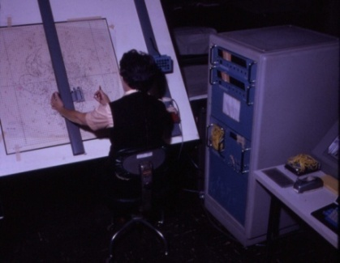
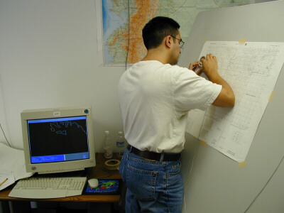
Creating Spatial Data - Digitizing
How?
Freehand
Manually trace the boundaries or features
Digital Tablet
An input device that enables you to enter drawings and sketches into a computer
E.g.
Manually Creating the Maps
Digitizing Tablets – Older
Digitizing Tablets - Newer

Slide 28
Creating Spatial Data - Digitizing
Process
Create empty shapefile using ArcCatalog
Set the coordinate system (to locate the feature correctly)
Trace the shape
Add attribute data

Slide 29
Lab 4
Digitizing shapefile
Adding fields, defining data types and entering data manually
Sorting, calculating field values
Joining data

