Slide 1
GEO 241: Geographic Information Systems I
Week 6: Spatial Analysis I: Selection / Queries,
Final Paper

Slide 2
Final Paper
Final Paper
Objective
Deliverables and Due Dates
Tasks and Steps

Slide 3
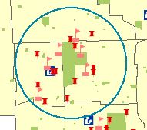
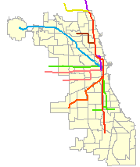
Why do we need a Selection or a Query?
(1) To select features based on a location or criteria
Selection
Query

Slide 4
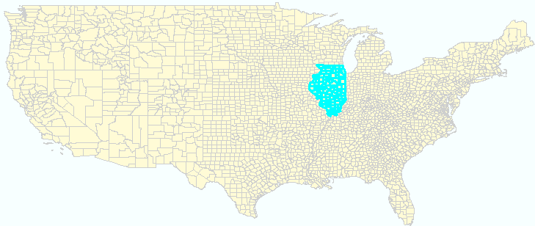
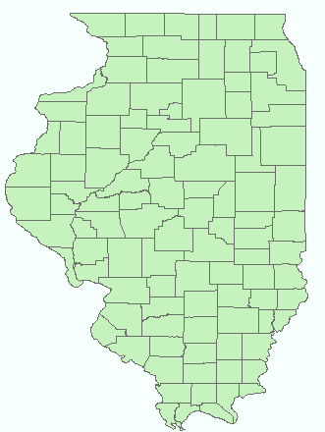
Why do we need a Selection or a Query?
(2) To create a new shapefile or layer with a subset

Slide 5
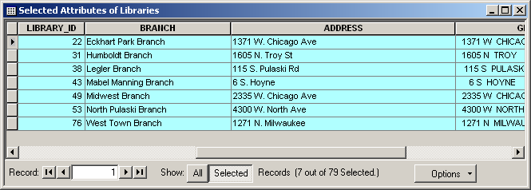
Why do we need a Selection or a Query?
(3) To edit or perform statistical calculations for a selected set of records
(4) To use the selected set for further analysis

Slide 6
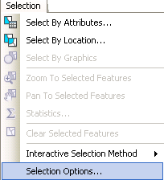
Available Selection / Query Tools
Select features
Select by attribute
(non-spatial queries)
Select by location
(spatial queries)
Select by graphics

Slide 7
Select by Location
Spatial query
Performed between 2 or more spatial features (shapefiles)
Not based on any attribute value(s)
Lets you select features based on their location relative to features in another layer.
You can use a variety of selection methods to select the point, line, or polygon features in one layer that are near or overlap the features in the same or another layer

Slide 8
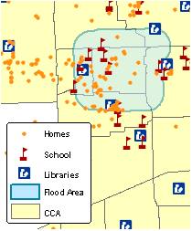
Select by Location
Example:
If you want to know how many
schools, libraries and homes
have to be evacuated due to a
flooding, and you mapped the
flood boundary, you could select
all the schools, libraries and
homes that are within this
flood area .
Performing this type of query
is known as a spatial query.

Slide 9
Select by Location – Selection Method
1. Intersect:
All features that intersect fully or partially with the features of another layer
Default method
Most commonly used selection method

Slide 10
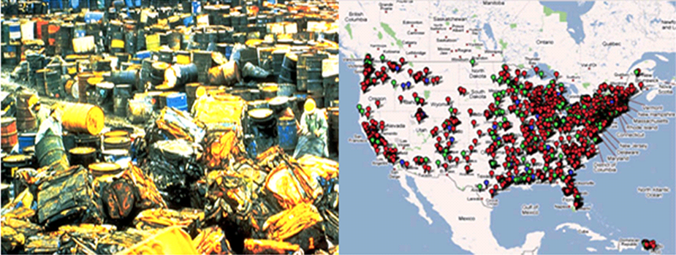
Select by Location – Selection Method
E.g. of Intersect:
From all the superfund sites, you can select out only the
ones that fall completely or partially within the state of
Illinois

Slide 11
Select by Location – Selection Method
2. Are within a distance of: (Proximity)
All features within a certain distance of features
of another layer. This operator creates buffers using the buffer distance around the source features and returns all the features intersecting the buffer zones
One of the commonly used methods

Slide 12
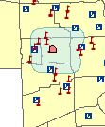
Select by Location – Selection Method
E.g. of Are within a distance of:
YMCA wants to identify the number of schools and libraries that are
within ½ mile from it’s location
YMCA

Slide 13
Select by Location – Selection Method
3. Completely contain: (Containment )
Features that are completely within another
feature
Features that touch the boundary do not get selected

Slide 14
Select by Location – Selection Method
E.g. of Completely contain:
Local alderman wants to know how many businesses are located within his/her ward?
How many (or which) TIF districts are within each community area?

Slide 15
Select by Location – Selection Method
4. Share a line segment with, Touch the
boundary of : (Adjacency )
Features that share the same boundary or touch the boundary

Slide 16
Select by Location – Selection Method
E.g. of Share a line segment with, Touch the boundary of :
How many county boundaries touch (or share) the oil spill area in Gulf of Mexico to identify the impact
How many houses share their property line with the utility lines
For road expansion, the Dept. of Transportation might want to know which properties share the boundary with the road

Slide 17
Select by Location – Selection Method
5. Other selection methods
Are completely within
Have their center in
Are identical to
Are crossed by the outline of
Contain
Are contained by

Slide 18
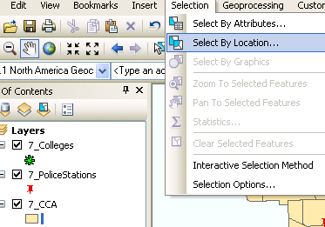
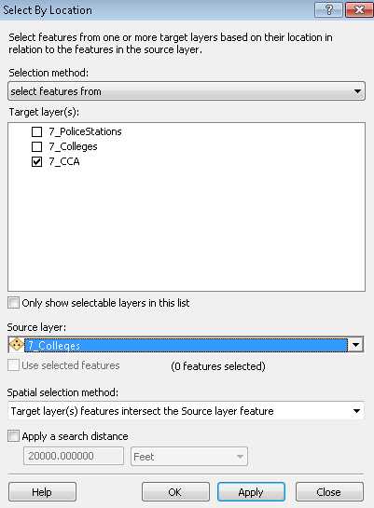
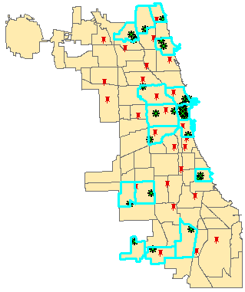
Selection by Location
Process : e.g. Select CCAs that have at least a college
2. Run the process
1. Select the option
3. Output

Slide 19
Select by Attribute
Non-spatial queries
Performed within a single table on attribute data
It uses a SQL (Structured Query Language) to perform the selection
Selection is based on a criteria or condition
i.e. select features using a “WHERE” clause

Slide 20
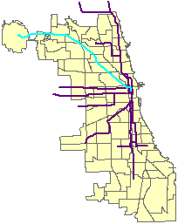
Select by Attribute
Example:
If you want to select only the blue
CTA train lines, and you have a
shapefile that has all the CTA
lines, you could select out only the
blue line train lines.
Performing this type of query
is known as a attribute query.

Slide 21
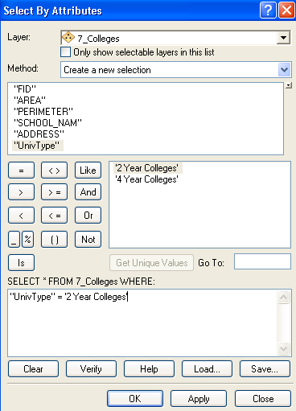
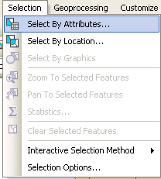
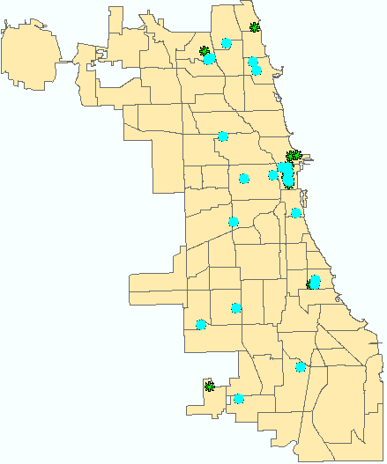
Select by Attribute
Process
2. Run the process
SQL
1. Select the option
3. Output

Slide 22
Select by Attribute
Writing SQL statements/commands
Syntax:
SELECT * FROM <table>
WHERE <field name> = <value>

Slide 23
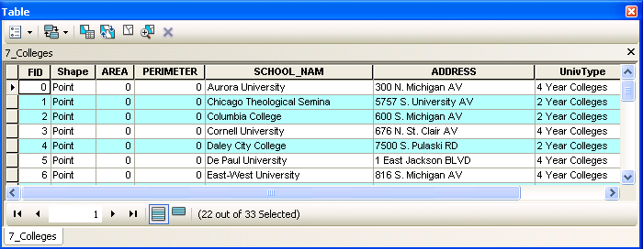
Select by Attribute
Query: SELECT * FROM 7_Colleges
WHERE “UnivType”= ‘4 Year Colleges’
Translation: Select all the records from 7_Colleges table that
satisfies the condition UnivType equal to 4 Year Collesges
Field Name
Column
Row
Value
Total # of records
Table Name

Slide 24
Select by Attribute
In ArcGIS, you will write only the condition
i.e.
SELECT * FROM 7_Colleges WHERE
“UnivType”= ‘4 Year Colleges’ Condition

Slide 25
Select by Attribute
SELECT * FROM <table> WHERE
<field name> OPERATOR <value> Condition
Common operators used in SQL statements
= | Equal to
> | Greater than
< | Less than
>= | Greater than or equal to
<= | Less than or equal to

Slide 26
Select by Attribute
Writing SQL statements/commands
Examples
SELECT * FROM BldUse WHERE “BldStatus” = ‘Good’ | SELECT * FROM BldUse WHERE “ProptyVal” < 124000
SELECT * FROM BldUse WHERE “ProptyVal” > 124000

Slide 27
Select by Attribute
If there are multiple conditions, you will use ‘AND’ or ‘OR’ to
combine conditions
AND | - Both conditions should be satisfied (Intersect)
OR | - Either one of the condition should be satisfied (Union)
SELECT * FROM BldUse
WHERE “BldStatus” = ‘Good’
AND “ProptyVal” = 160000
SELECT * FROM BldUse
WHERE “ProptyVal” > 200000
AND “ProptyVal” < 300000

Slide 28
Select by Attribute
Question: Which records will be selected?
“ProptyVal” >= 124000
“BldStatus” = ‘Good’
3. “BldStatus” = ‘Dilapidated’
4. “BldStatus” = ‘Good’ AND “ProptyVal” = 160000
5. “BldStatus” = ‘Good’ OR “ProptyVal” = 160000

Slide 29
Select by Attribute
Writing SQL statements/commands
Few things you should know about Values
When specifying values in your query
- Text fields should be enclosed within single quotes
E.g. “BldStatus” = ‘Good’
- Number fields should NOT be enclosed within single quotes; no
comma separators
E.g. “ProptyVal” = 160000
Values are case sensitive. i.e. GOOD ≠ Good ≠ gOOD

Slide 30
Worried about Queries?
If you are new to writing queries, DO NOT worry!
You can use the wizards to create the query.

Slide 31
Selection / Queries…
How to clear selection

Slide 32
Selection / Queries…
How to switch selection

Slide 33
Selection / Queries…
Very powerful analysis tools
Can be used for
Analyzing data
Creating new datasets
Search / query
Isolate certain values / features
Isolate to perform further calculations
Clean-up / modify / add data
Can be used individually or together

Slide 34
Selection / Queries…
Using both types of queries: (Spatial and Attribute)
By combining queries, you can perform more complex searches
E.g. Suppose you want to find all the customers who live within a 20-mile radius of your store and who spent more than $1,000 the current calendar year at the store so you can send them a $100 gift card
You would first select the customers within this 20-mile radius (select by location)
Then refine the selection by finding those customers who have spent more than $1,000 made a purchase within the current calendar year (select by attribute)

Slide 35
Selection / Queries…
How to decide when to use Selection and when to use Queries?
E.g.
How many Colleges are “4 Year Colleges”?
How many Zipcodes have at least one (intersect) College?
Hint:
Selection:
if there are 2 or more shapefiles (e.g. How many Zipcodes have at least one (intersect) College – there are 2 shapefiles mentioned here, the zipcodes and colleges )
you will see select by location methods like intersect, within a distance of mentioned
Query :
if there is only 1 shapefile (e.g. How many Colleges are “4 Year Colleges”? )
The condition is based on a field value (e.g. ‘4 Year Colleges’)

Slide 36
Lab 5
Performing spatial queries (Select by Location)
Performing attribute queries (Select by Attributes)
Creating subsets with queries
Performing spatial analysis
Mapping using queries

Slide 37
Next Week (Week 7)
What's due
Assignment 5 due Friday midnight

