Slide 1
GEO 241: Geographic Information Systems I
Week 7: Spatial Analysis II: Buffer Analysis, Geocoding

Slide 2

ArcGIS Software
ArcView
v 10
ArcEditor
v 10
ArcInfo
v 10
ArcMap
ArcCatalog
ArcToolbox
To create maps, map layouts
For data manipulation, create organize shapefiles, folders etc.
For functions, analytical tools, etc.

Slide 3
ArcGIS Software
ArcView
v 10
ArcEditor
v 10
ArcInfo
v 10
ArcMap
ArcCatalog
ArcToolbox
To create maps, map layouts
For data manipulation, create organize shapefiles, folders etc.
For functions, analytical tools, etc.

Slide 4
Buffer Analysis
Buffer analysis is used for identifying areas surrounding geographic features
The process involves generating a buffer around existing geographic features and then identifying or selecting features based on whether they fall inside or outside the boundary of the buffer
Creates a new polygon

Slide 5
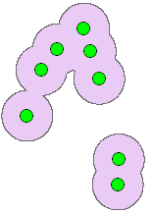

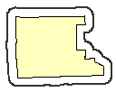
Buffer Analysis (Contd.)
Applied to points, lines, or polygons
¼ mile buffer around
Pink CTA line
¼ mile buffer
Around Humboldt
Park neighborhood
½ mile buffer
around schools

Slide 6
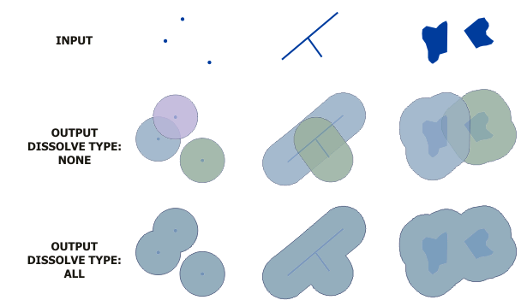
Buffer Analysis (Contd.)
Setting dissolve type

Slide 7
Buffer Analysis (Contd.)
To Dissolve or Not to Dissolve?
Commuter plan crashing into traffic causing multi-vehicle accident
20 feet
Driver witnessing the plan crash causes multi- vehicle accident

Slide 8
Buffer Analysis (Contd.)
Types of Buffers
  Single ring buffer
    Outside buffer
    Inside buffer
  (2) Multiple ring buffer

Slide 9
Buffer Analysis (Contd.)
Single ring buffer
(1) Outside buffer: To identify what features are in the outside buffer polygon?
(2) Inside buffer: To identify what features are in the inside buffer polygon?
Lake
Buffer outside
Lake
Lake
Inside buffer

Slide 10
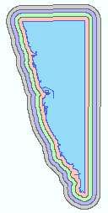

Buffer Analysis (Contd.)
Multiple ring buffer
To identify features within each of the buffer areas
Could be multiple inside buffers or multiple outside buffers

Slide 11
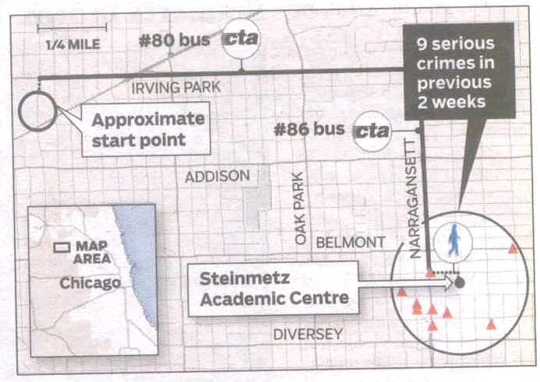
Buffer Analysis (Contd.)
Examples

Slide 12
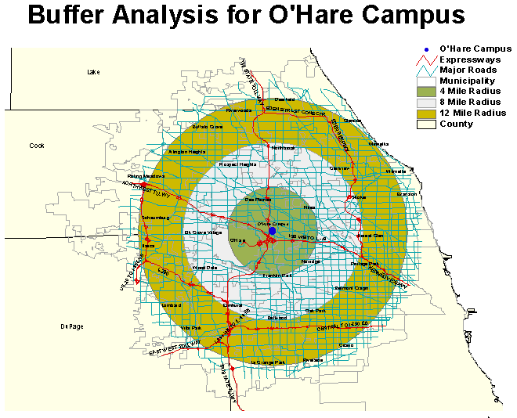
Buffer Analysis (Contd.)
Examples
 | 0-4 Mile | 0-8 Mile | 0-12 Mile
Total Population | 185,517 | 831,254 | 2,068,803
College Education 4 or More Years | 24,078 | 98,378 | 241,017
Number of Enrolled High School Students | 8,718 | 42,712 | 114,882
Total Households | 72,819 | 310,352 | 741,472
$60,000 - $100,000 | 19,341 | 30,308 | 180,386
$100,000 or more | 12,360 | 50,495 | 123,557

Slide 13
Buffer Analysis (Contd.)
Examples…
  If we know that a chemical spill will cause harm to anyone within 1 mile of its release site, we could buffer the places that chemical is stored, and use that information to plan our emergency response system
  If we want to assess the number of commuters affected within a 4-block radius of a CTA station closing, we could create a buffer area around the particular CTS station and compute the number of commuters who will be affected by this closing
  If we want to know the crime rate within 1-block radius of all CTA stations, a buffer area could be created around the CTA train stations and the number of crime committed within the buffer area could be calculated

Slide 14
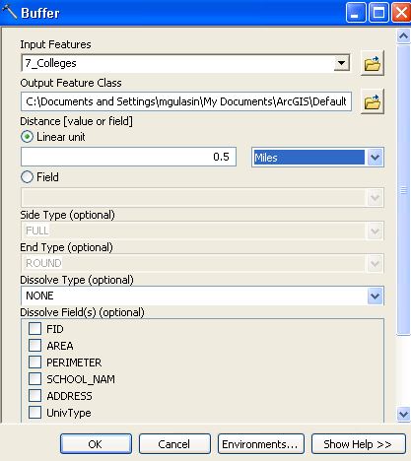
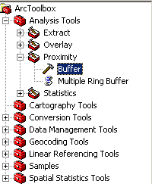
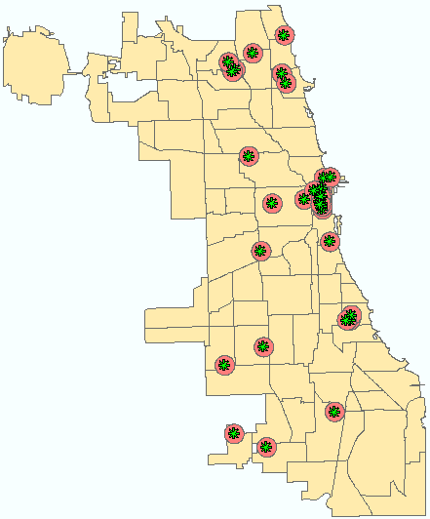
Buffer Analysis (Contd.)
Process
Feature around
which you want to
create the buffer
area
File name of the buffer area
Buffer distance
Dissolve Type
(see lab activity)

Slide 15
Buffer Analysis (Contd.)
Important
Map MUST have units of measurement
Georeference should be accurate otherwise the buffer distance will be inaccurate causing incorrect buffer distances

Slide 16
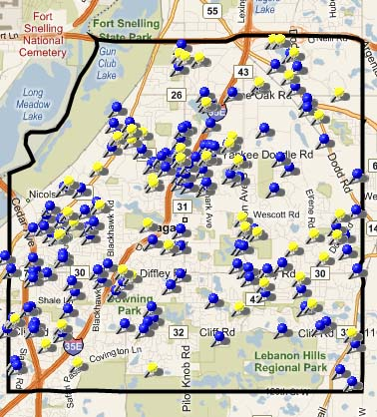
Working with Address Level Data
What is Address Level Data?
Addresses of various locations
E.g.
  - addresses of customers
  - factory sites
  - club member locations
  - shopping malls
  - grocery stores
  - crime locations
  - foreclosed homes

Slide 17
Working with Address Level Data
Why is it difficult to obtain Address Level
shapefiles?
Most often the Address Level data is specific to a particular organization/industry
  E.g.
    Customer location of KHOLS
    Foreclosed properties owned by a particular bank
They are not static, they change all the time
  E.g.
    Crime locations
    Homes listed for sale

Slide 18
Working with Address Level Data
Methods of converting Address Level data to
point shapefile
Geocoding (using ArcMap)
Batch Geocoding*
Gathering data using GPS device*
* Will not be covered

Slide 19
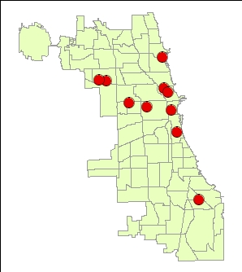
Geocoding
It is a process of converting address locations to point shapefiles
Name | Address | CPS_Type
Chicago Vocational | 2100 E 87th St | Vocational
Best Practice | 2040 W Adams St | General/Technical
Dunbar | 3000 S Dr Martin Luther Kin Dr | Vocational
Flower | 3545 W Fulton Blvd | Vocational
Near North | 1450 N Larrabee St | High School Magnet
Jones | 606 S State St | High School Magnet
Prosser | 2148 N Long Av | Vocational
Rodriguez Apc | 630 W Irving Park Rd | General/Technical
Payton | 1034 N Wells St | General/Technical
Harvey Apc | 2245 N Mc Vicker Av | General/Technical

Slide 20
Geocoding
How do we Geocode?
You have an address location and a streets network
The address location is matched to the street network
Once matched, it will create a point location

Slide 21
Geocoding
200 N Adams
N
Left
Right
Step 1. Segment the address
| N | Adams
Step 2. Find the Street
Step 3. Find the direction
Step 4. Find the house# segment
Step 5. Locate the point
395
400
201
200
Adams
01
02
101
120
S

Slide 22
Geocoding
Question: Where will each addresses be located on
the street?
1. 200 N Adams
2. 385 N Adams
3. 4 S Adams
4. 122 S Adams
5. 404 N Adams
N
Left
Right
395
400
201
200
Adams
01
02
101
120

Slide 23
Geocoding
Ans: Where will each addresses be located on
the street?
1. 200 N Adams
2. 385 N Adams
3. 4 S Adams
4. 122 S Adams (out of range, will not locate)
5. 404 N Adams (out of range, will not locate)
N
Left
Right
395
400
201
200
01
Adams
02
101
120
S

Slide 24
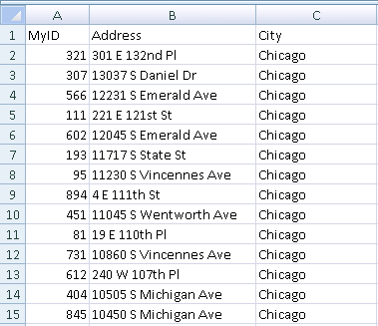
Geocoding
What do you need to geocode addresses
1. Address locations
  Data should be in .dbf or .csv format
  If you have data in excel format, “save as” .dbf or .csv file
Should be in this format –
i.e.
- Field Names on the 1st row
- Data starting from 2nd row
- Should have an Address field

Slide 25
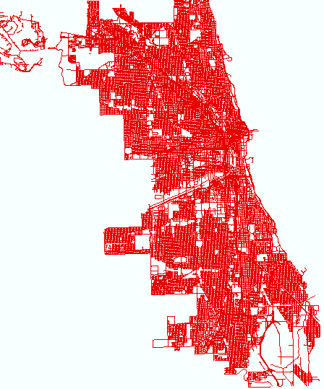
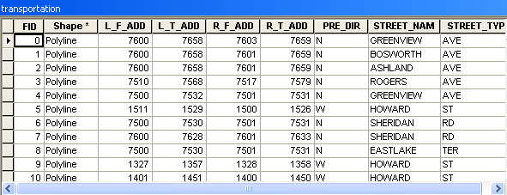
Geocoding
What do you need to geocode addresses
2. Street network
  Will be used as the reference data file to plot the address locations
Left Hand Side (LHS)
From and To Ranges
Right Hand Side (RHS)
From and To Ranges
Street Network (Shapefile)

Slide 26
Geocoding
What do you need to geocode addresses
3. Geocoding service or Address Locator
  Includes the process or rules as to how the address will be placed/plotted on the street network. i.e. right or left, etc.
  Uses the Street network file (mentioned above) to build the rules
  Predefined or can be defined by the user

Slide 27
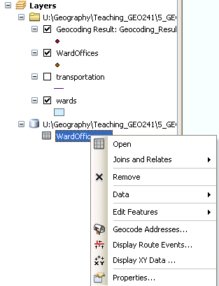
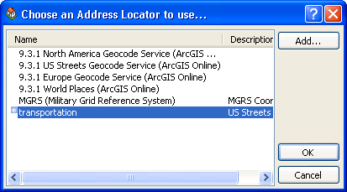
Geocoding
Process
2. Click on “Add” and select the transportation locator. Press OK.
Once added double click on transportation locator
1. Right click on .csv file, select Geocode Address

Slide 28
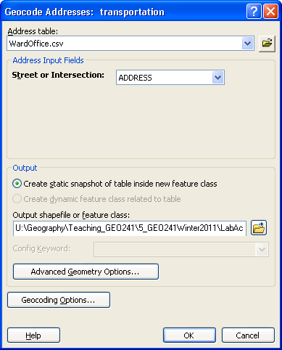
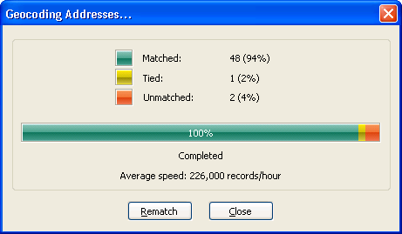
Geocoding
4. Shows matched/ unmatched record counts
3. Enter the resulting file name. Press OK.
5. Rematch to correct unmatched records.

Slide 29
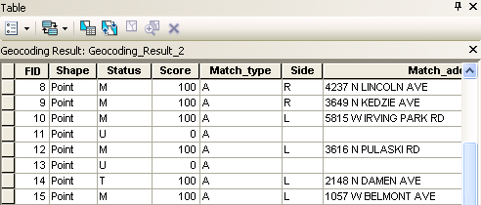
Geocoding
New fields created in the output shapefile
Status
  U – Unmatched
  T – Tied
  M - Matched
Score – match score
Side – side of the street the address was matched
ARC_Street – Address information that was geocoded

Slide 30
Geocoding
Pros and Cons of using Geocoding
Pros:
Takes less time to convert massive amount of address locations to point shapefile
  E.g. 2 million address locations takes about 2-3 hours to convert to address locations
Requires only ArcMap (and excel to clean up the data)
Can review and correct unmatched records
Can see matched status (Matched, Unmatched, Tied)
Re-geocode unmatched records later

Slide 31
Geocoding
Pros and Cons of using Geocoding
Cons:
If the streets network file doesn’t have the address range, it will not convert your address location
If the streets network file is outdated most of your address points wont be converted

Slide 32
Lab 6
Create buffers around features and analyze surrounding features
Create point shapefiles of various address locations using geocoding
Create maps with the geocoded data and buffers

Slide 33
Next Week (Week 8) – IMPORTANT!!!
Assignment 6 due Friday midnight

