Slide 1
GEO 241: Geographic Information Systems I
Week 8: Raster Data Model
Geographic Extent and Unit of Analysis
Data Sources

Slide 2
Raster Data Model
Raster is another method for storing, processing and displaying spatial data
Raster data is an abstraction of the
real world
Individual grid cells in raster images
are referred to as "picture elements"
or "pixels"
Example: (.jpg, .gif, .tiff, .sid, etc.)
Remote sensing data: (data recorded from a distance)
digital aerial photographs, imagery from satellites
Other digital formats:
digital pictures, scanned maps

Slide 3
Raster Data Model (Contd.)
Each area is divided into rows and columns, which form a regular grid structure
Points associated with single grid cell
Lines are a connected sequence of cells
Areas are a sequence of interconnected cells
Point
Line
Polygon
Vector
Raster

Slide 4
Raster Data Model (Contd.)
Raster images are routinely used for
topographic mapping
urban planning
geological and soils mapping
agricultural applications
forest management
disaster assessment
military

Slide 5
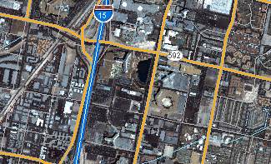
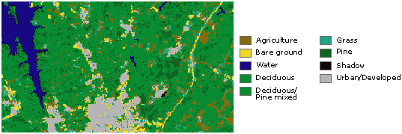
Raster Data Model (Contd.)
Applications
Rasters as base maps used in conjunction with vector data
Rasters as thematic maps
Raster
aerial photograph
background display
represent real objects
Vector
road network
Raster
satellite image
represents land-
cover categories

Slide 6
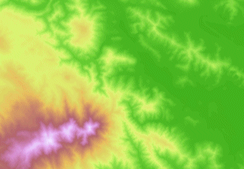
Raster Data Model (Contd.)
Applications
Rasters as surface maps
Rasters as attributes
Raster
satellite image
suited for representing data that
changes continuously across a landscape
(surface)
Vector
volcano and volcano eruption area
Volcano
Volcano eruption area
Raster
aerial photo
represents landmark

Slide 7
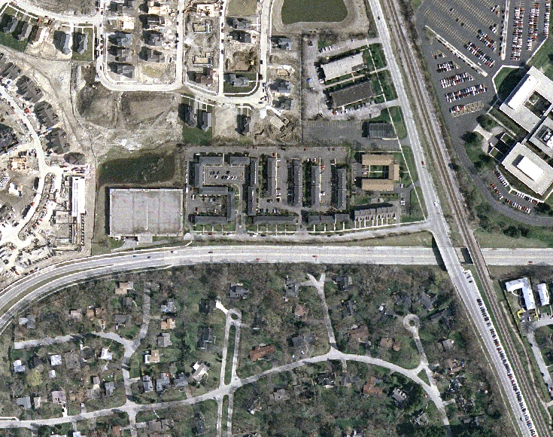
Raster Data Model (Contd.)
Applications
For digitizing
Raster
satellite image
Vector
digitized buildings (polygon) shapefile

Slide 8
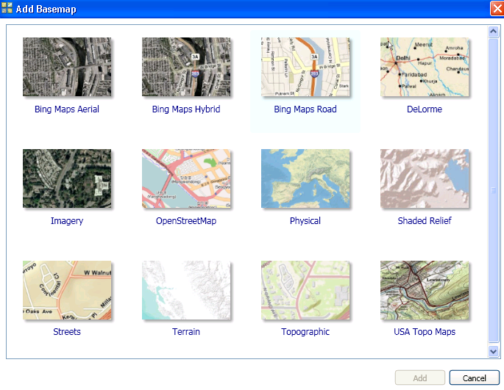
Raster Data Model (Contd.)

Slide 9
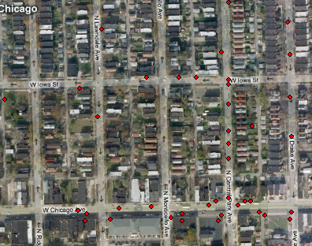
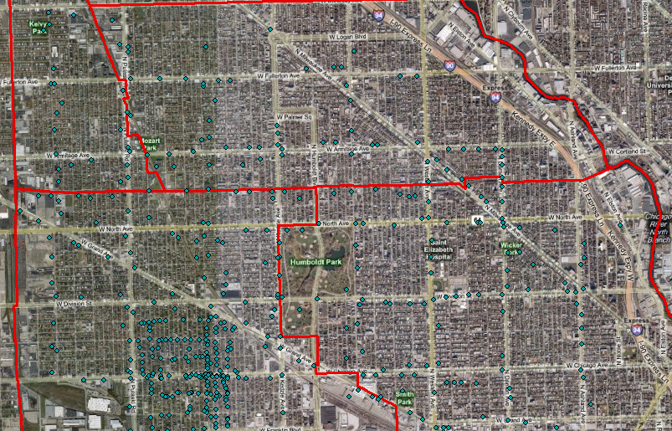
Raster Data Model (Contd.)
Bing Maps Hybrid

Slide 10
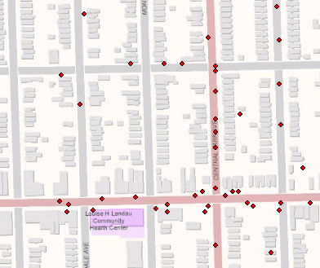
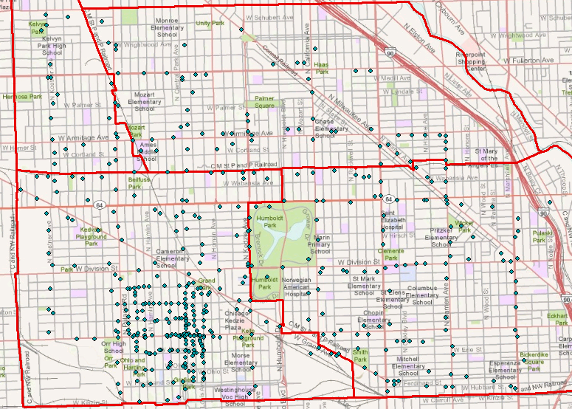
Raster Data Model (Contd.)
Topographic

Slide 11
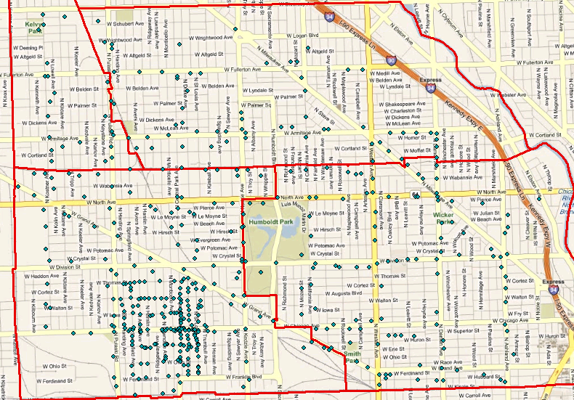
Raster Data Model (Contd.)
Bing Maps Road

Slide 12
Geographic Extent and Unit of Analysis
What is a Geographic Extent?
It is the project area or study area boundary
What is a Unit of Analysis?
It is the units by which the data is reported or gathered
It is a smaller geographic unit (sub geography)

Slide 13
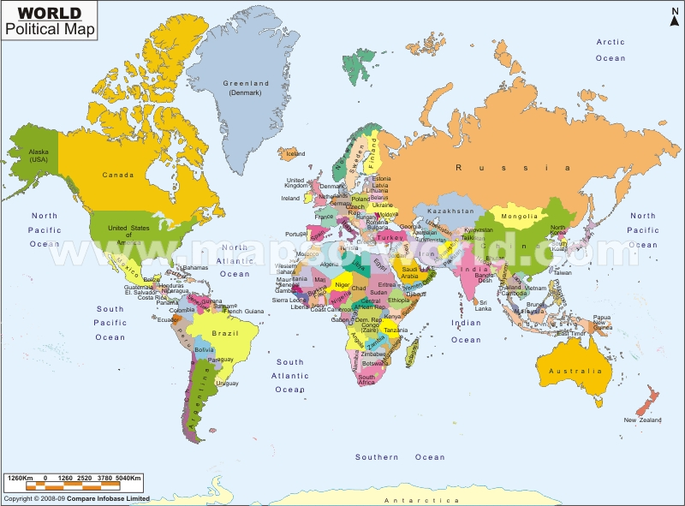
Geographic Extent and Unit of Analysis (Contd.)
Examples: World
Geographic Extent: World
Unit of Analysis: Continent
Geographic Extent: World
Unit of Analysis : Country

Slide 14
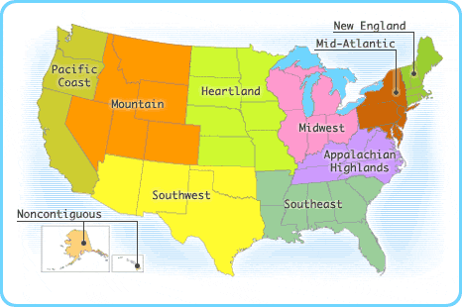
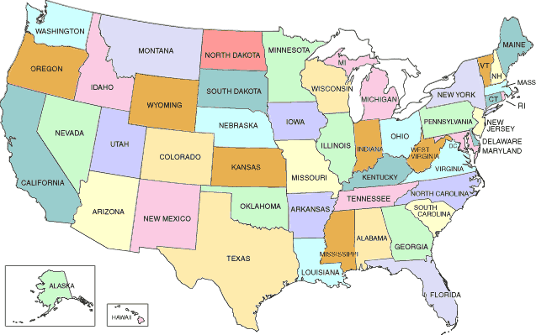
Geographic Extent and Unit of Analysis (Contd.)
Examples: USA
Geographic Extent: U.S.A
Unit of Analysis: Region
Geographic Extent: U.S.A
Unit of Analysis: State

Slide 15
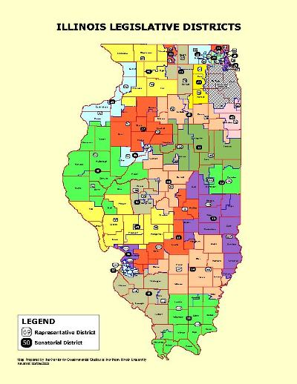
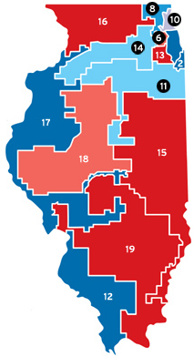
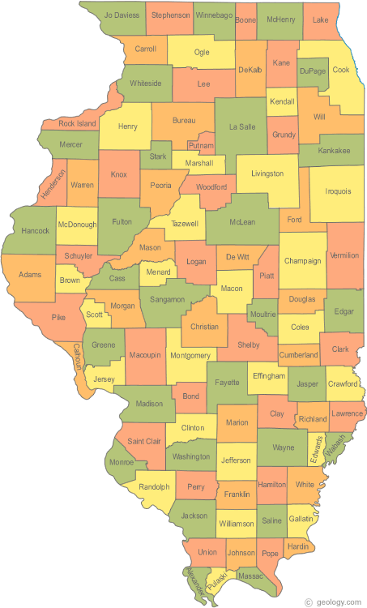
Geographic Extent and Unit of Analysis (Contd.)
Examples: Illinois
Geographic Extent: State
Unit of Analysis:
Congressional District
Geographic Extent: State
Unit of Analysis: County
Geographic Extent: State
Unit of Analysis: Legislative
District

Slide 16
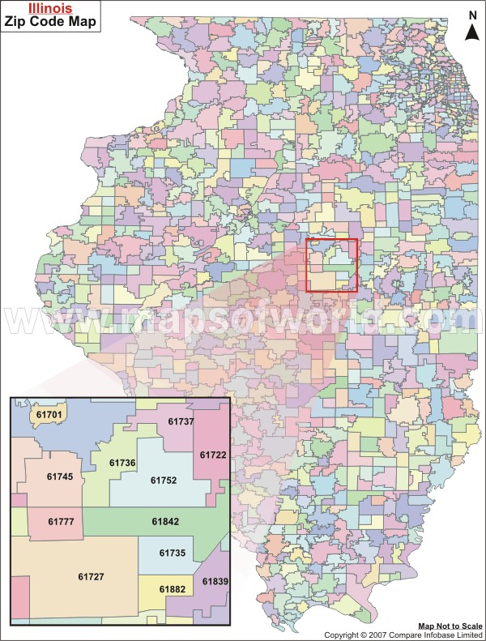
Geographic Extent and Unit of Analysis (Contd.)
Examples: Illinois
Geographic Extent: State
Unit of Analysis: Zip code

Slide 17
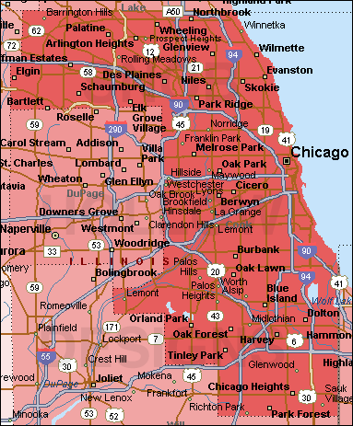
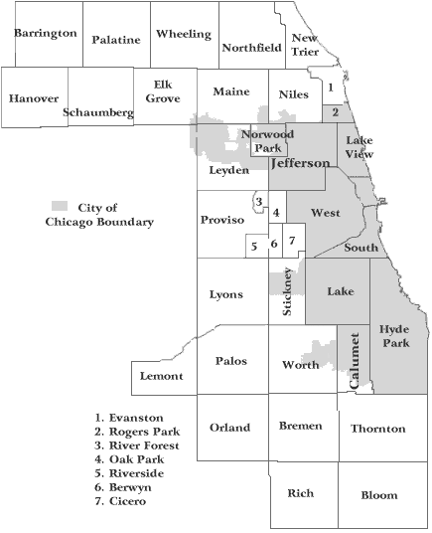
Geographic Extent and Unit of Analysis (Contd.)
Examples: Cook County
Geographic Extent: Cook County
Unit of Analysis: Township
Geographic Extent: Cook County
Unit of Analysis: Municipality

Slide 18
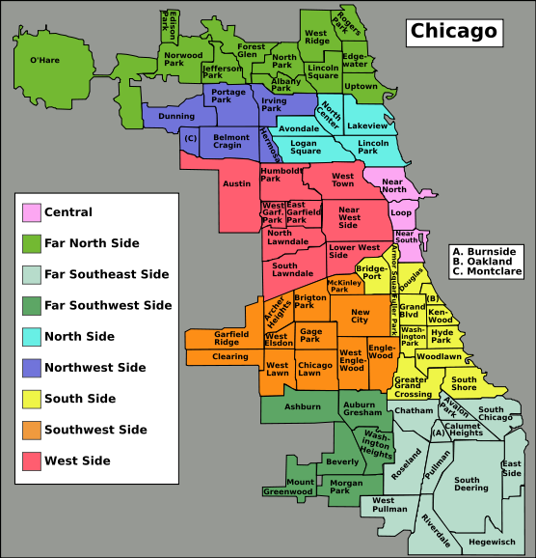
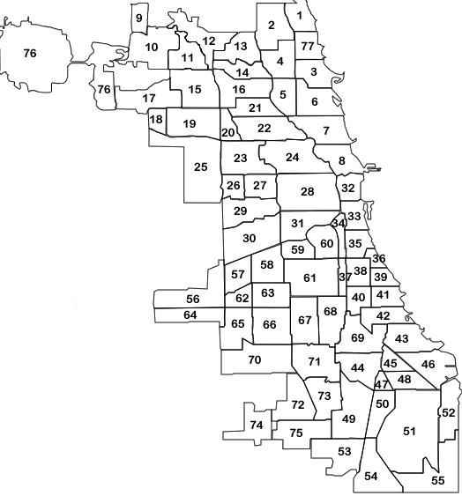
Geographic Extent and Unit of Analysis (Contd.)
Examples: Chicago
Geographic Extent: Chicago
Unit of Analysis: Chicago Community Areas
Geographic Extent: Chicago
Unit of Analysis: Chicago Regions

Slide 19
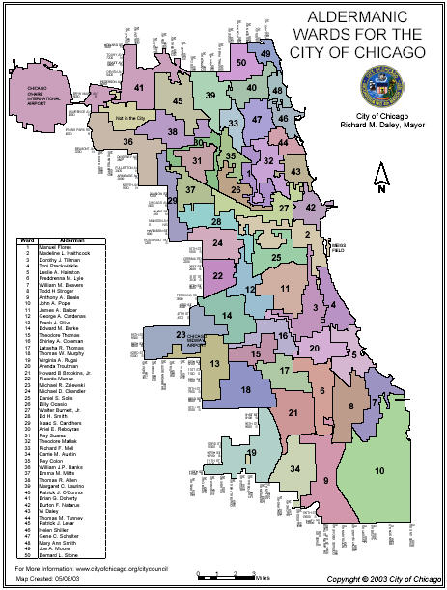
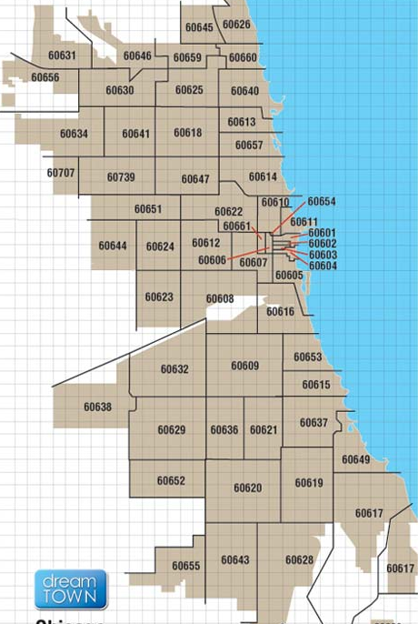
Geographic Extent and Unit of Analysis (Contd.)
Examples: Chicago
Geographic Extent: Chicago
Unit of Analysis: Zip code
Geographic Extent: Chicago
Unit of Analysis: Wards

Slide 20
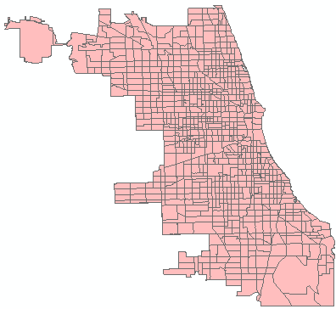
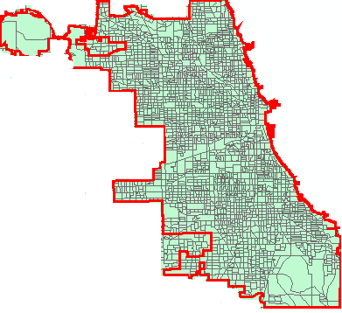
Geographic Extent and Unit of Analysis (Contd.)
Examples: Chicago
Geographic Extent: Chicago
Unit of Analysis: Tract
Geographic Extent: Chicago
Unit of Analysis: Block Group

Slide 21
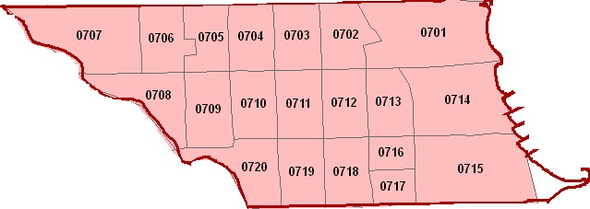
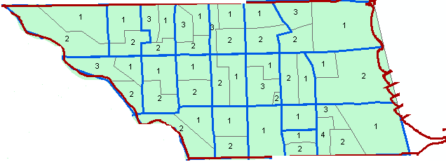
Geographic Extent and Unit of Analysis (Contd.)
Examples: Community Area (Lincoln Park)
Geographic Extent: Community Area
Unit of Analysis: Tract
Geographic Extent: Community Area
Unit of Analysis: Block Group

Slide 22
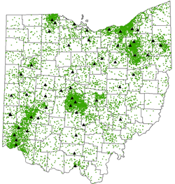
Geographic Extent and Unit of Analysis (Contd.)
Examples:
Geographic Extent: State (Ohio)
Unit of Analysis: Address Locations (Point)

Slide 23
Geographic Extent and Unit of Analysis (Contd.)
Why do we need geographic extent and unit of analysis?
Geographic Extent
To know the study area
To know the area to collect data
Unit of Analysis
To collect data

Slide 24
Geographic Extent and Unit of Analysis (Contd.)
Example: (1) Chicago Police Department:
http://gis.chicagopolice.org/CLEARMap_crime_sums/startPage.htm
Geographic Extent: Chicago
Unit of Analysis :
- Chicago Community Areas
- Police Districts
- Police Beats
- Tracts
- Wards
- Address level (only last 2 weeks)

Slide 25
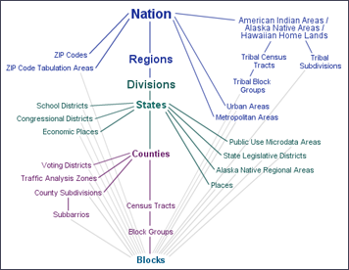
Geographic Extent and Unit of Analysis (Contd.)
Example: (2) Census: http://factfinder2.census.gov/faces/nav/jsf/pages/index.xhtml
Geographic Extent: USA
Unit of Analysis : ------------→

Slide 26
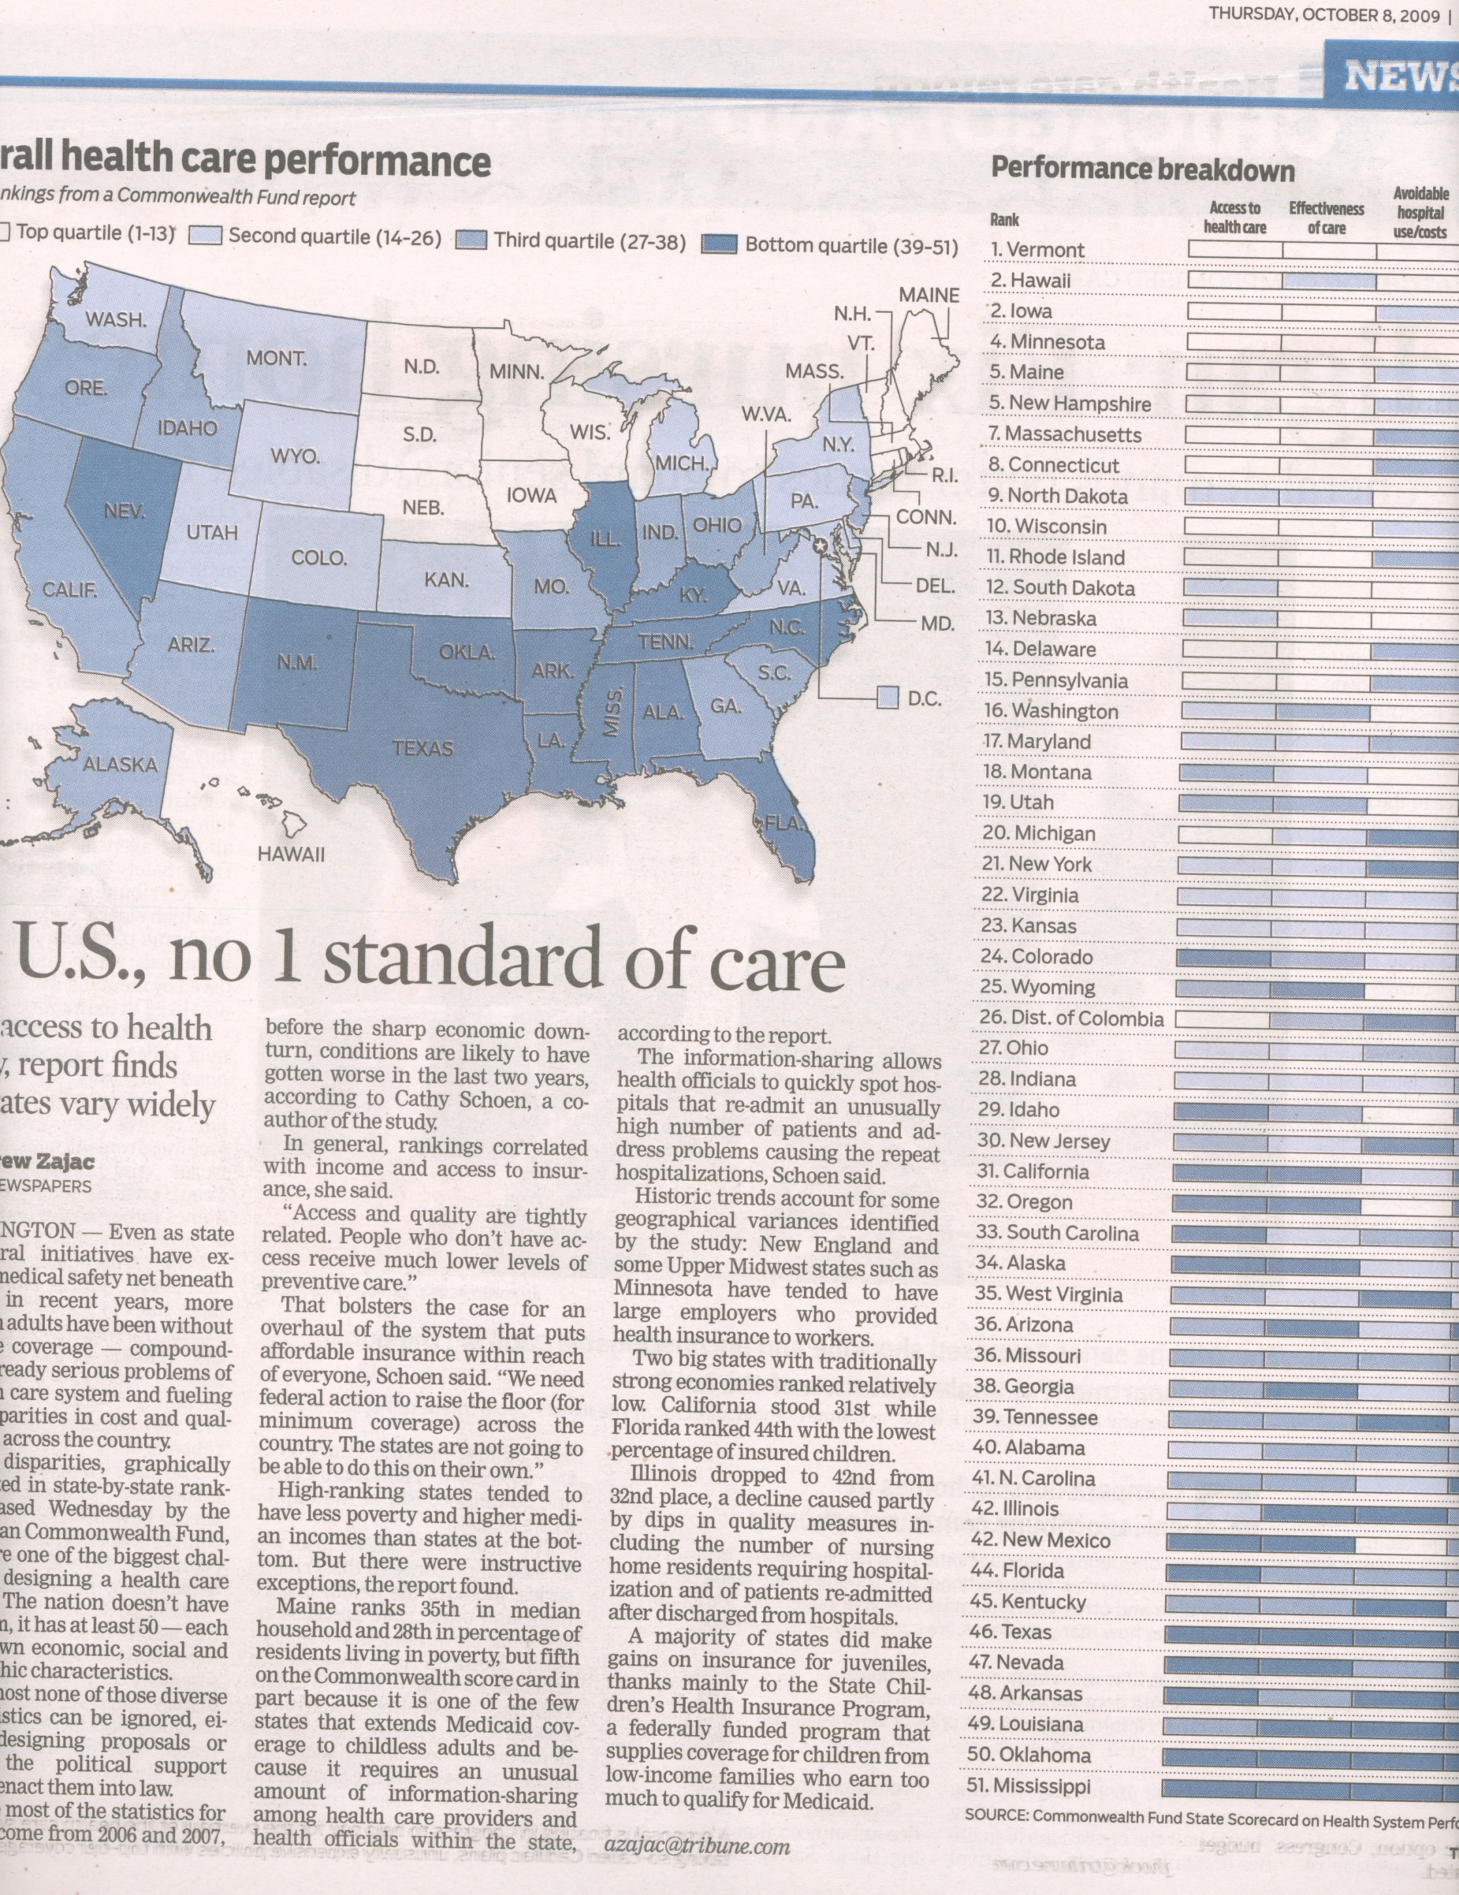
Geographic Extent and Unit of Analysis (Contd.)

Slide 27
Data Sources
Data sources are documents, people, and observations that provide information
Where can I get data?
Websites
Reports
Publications
Survey
Interviews
Observation
How do we cite the source?
e.g. U.S. Census 2000
U.S. Census 1990-2000 data summarized by IHS, DePaul University

Slide 28
Data Sources (Contd.)
What types of data do I need to create maps?
Spatial data
Shapefiles
- Existing – Readily available
- Creating your own shapefiles
Aerial / Raster images
Attribute data
- Existing
- Compute from existing

Slide 29
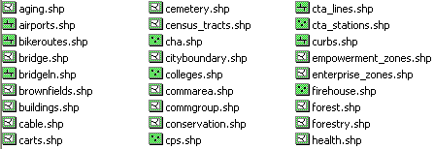
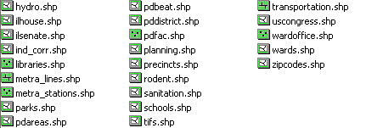
Data Sources (Contd.)
Where do we get spatial (shapefiles) data?
(1) Spatial - Existing
Geography Dept: W:\classres\LA&S\GEOG\MCHAFFIE\razvi-hague\City of Chicago Shape files
City of Chicago’s GIS department ( )
U.S. Census ( )
See Final Paper “Data Sources” for additional data sources
Link
Link

Slide 30
Data Sources (Contd.)
Where do we get spatial (shapefiles) data?
(2) Spatial – Creating your own
Selecting a subset (using selection or query) and exporting it as a new shapefile (point, line, polygon)
Convert address locations to point shapefiles using Geocoding
Create new shapefiles (point, line, polygon) using Digitizing
New shapefiles using Buffer analysis

Slide 31
Data Sources (Contd.)
Where do we get the attribute data?
(3) Non-spatial / Attribute
U.S. Census ( )
City of Chicago – Departments ( )
Census data summarized by CCAs – 1990 ( )
Crime – Chicago ( )
Historic Census – 1930 to 2000 ( )
Recovery.gov ( )
Search on the web…
Link
Link
Link
Link
Link
Link

Slide 32
Data Sources (Contd.)
Where do we get the aerial data?
(4) Aerial images
Use ‘Add Basemaps…’ option in ArcMap

Slide 33
Lab 7
Add aerial images, create maps with vector and raster data
Download spatial and attribute data
Create subsets using selection or query and exporting it to new shapefiles
Obtaining attribute data, combining it with spatial data to create maps

Slide 34
Next Week – (Week 9) IMPORTANT!!!
Assignment 7 due Friday midnight
Final Paper Part I due Friday midnight

