Slide 1
GEO 241: Geographic Information Systems I
Week 9: New Developments in GIS
GIS Resources,
Final Paper Preparation

Slide 2



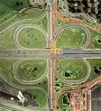







New Developments in GIS
Users → Sophisticated
GIS Applications
Methodology
Data
Technology
Hardware
Devices
GIS Software
As users get sophisticated the methodology, technology (hardware, software, devices), data and applications also become advanced

Slide 3
New Developments in GIS
Recent developments are mainly due to
GIS Awareness and Use by
General Public
  Moved from looking at traditional road maps to MapQuest to GPS
  devices
  Taking Polaroid photos to digital images which are geotagged
  Finding places on Atlas to using Google Earth
  Finding information about their neighborhood, election results, etc.
(b) Organizations
  For wide range of applications to provide better, faster services to
  clients (e.g. Restaurant locations, traffic flow, disaster area)
  Reduce costs, increase profit margins (e.g. Fleet management,
  effective delivery routes)

Slide 4
New Developments in GIS
Recent developments are mainly due to
2. New Technologies
  Software, hardware, devices/accessories (e.g. GIS, GPS, PDAs)
  Applications/programs (e.g. Web-based mapping, Google Earth)
  Methods (e.g. Real-time data gathering and dissemination)

Slide 5
New Developments in GIS Technologies
Location based service (LBS)
  Information gathering:
  Then – Information was gathered using field survey
  Now – information is gathered using sophisticated handheld wireless devices, GPS devices with GNSS technology
  Uses: Real-time data, photos and videos on
    Traffic: events (accidents), congestion, travel times
    Finding nearby locations: restaurants, gas stations

Slide 6
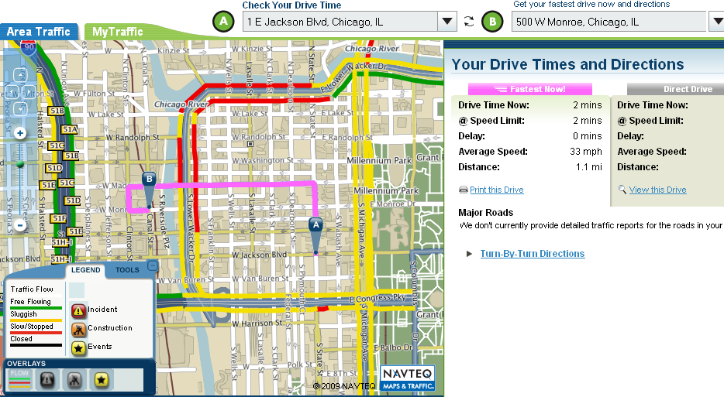
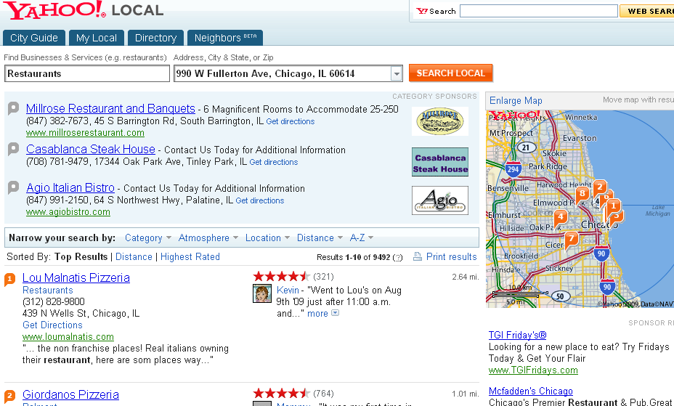
New Developments in GIS Technologies (Contd.)
Location based service (Contd.)
  Example:
Navteq’s traffic report system
Yahoo’s location finder

Slide 7
New Developments in GIS Technologies (Contd.)
2. Real-time Data Gathering
  Information gathering:
  Then – emergency planning was limited to paper / hard copy maps. Information gathering equipment / devices were bulky and heavy; technology was slow and expensive
  Now – Real-time information gathering and communication
  Uses: Real-time data, photos, videos and communication
    Wildfire: location, burn area
    Natural disaster: assessment of affected area
    Law enforcement, emergency management, city govt.

Slide 8
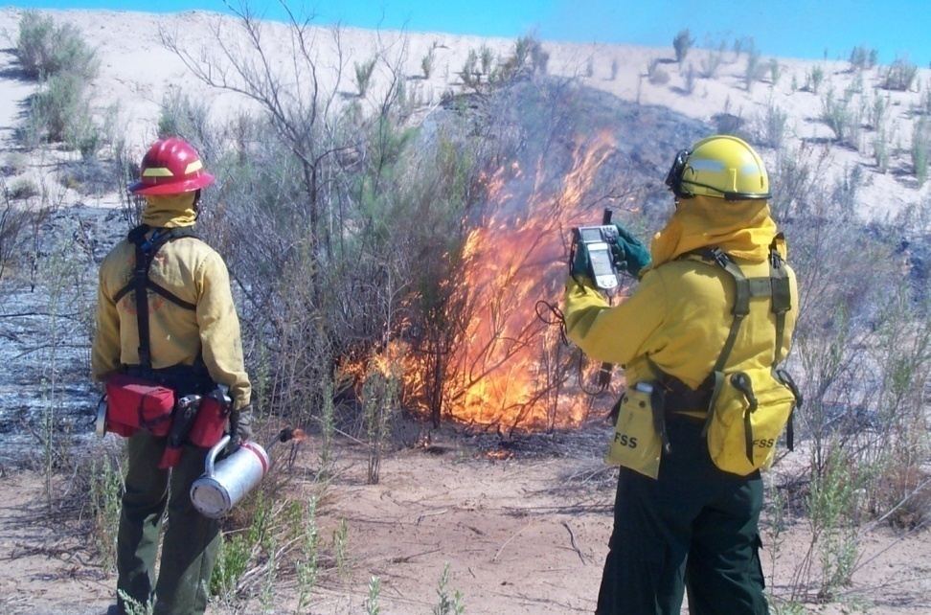

New Developments in GIS Technologies (Contd.)
2. Real-time Data Gathering (Contd.)
  Example:
Fire Dept. uses GIS technology to identify the location, burn location and magnitude of the fire
Law enforcement and military uses GIS for navigation and disaster area/boundary etc.

Slide 9
New Developments in GIS Technologies (Contd.)
3. Data Collection Equipment & Accessories
  Information gathering:
  Then – Information was gathered manually using field survey
  Now – information is gathered using hand held wireless devices, digital cameras, satellites, unmanned aerial vehicles
  Uses: Real-time data, photos and videos on
    Land Survey: Land use information suing ground-based laser scanning (higher accuracy and quality)
    Geocoding: locating address points/locations (lat/long)

Slide 10


New Developments in GIS Technologies (Contd.)
3. Data Collection Equipment & Accessories (Contd.)
  Example:
Location based data is collected using handheld devices
Aerial images/ land scanning is done to take stock of the land use/ inventory

Slide 11
New Developments in GIS Technologies (Contd.)
4. Web-based Mapping and other Applications
  Information dissemination:
  Then – Limited to paper mapping
  Now – real-time information is available on the web. Maps are created dynamically (on the fly). Expanded the breath of GIS/ spatial data users . Information could be created by users with no prior GIS knowledge
  Uses: Real-time data, photos and videos on the web for
    Direction and navigation
    Spatial locations
    Public Participatory GIS (PPGIS) – Public can use web-based mapping for decision making, planning and information gathering

Slide 12
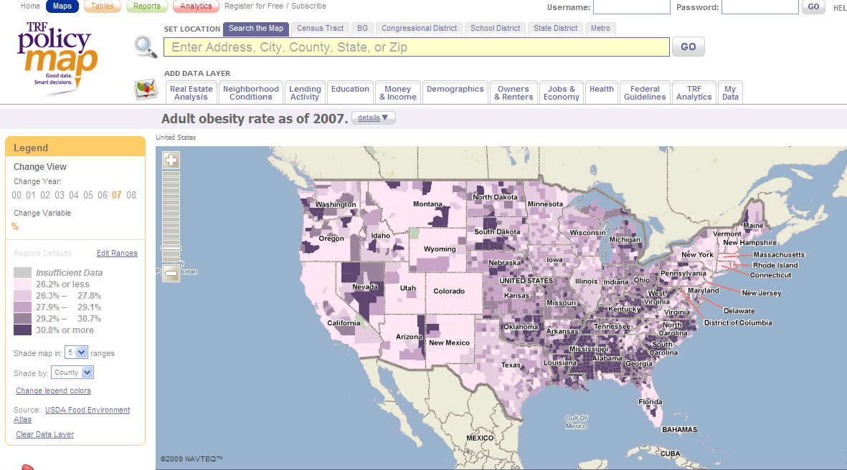
New Developments in GIS Technologies (Contd.)
4. Web-based Mapping and other Applications (Contd.)
  Example: PolicyMap (Click Here)

Slide 13
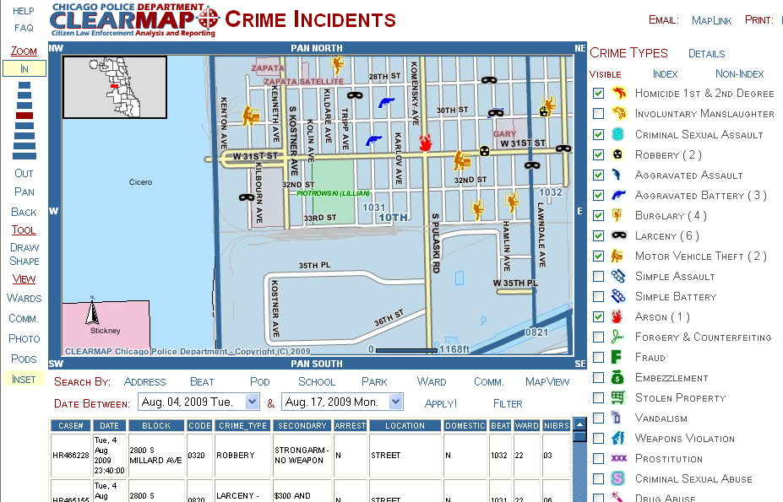
New Developments in GIS Technologies (Contd.)
4. Web-based Mapping and other Applications (Contd.)
  Example: CPD’s Clear Map (Click Here)

Slide 14
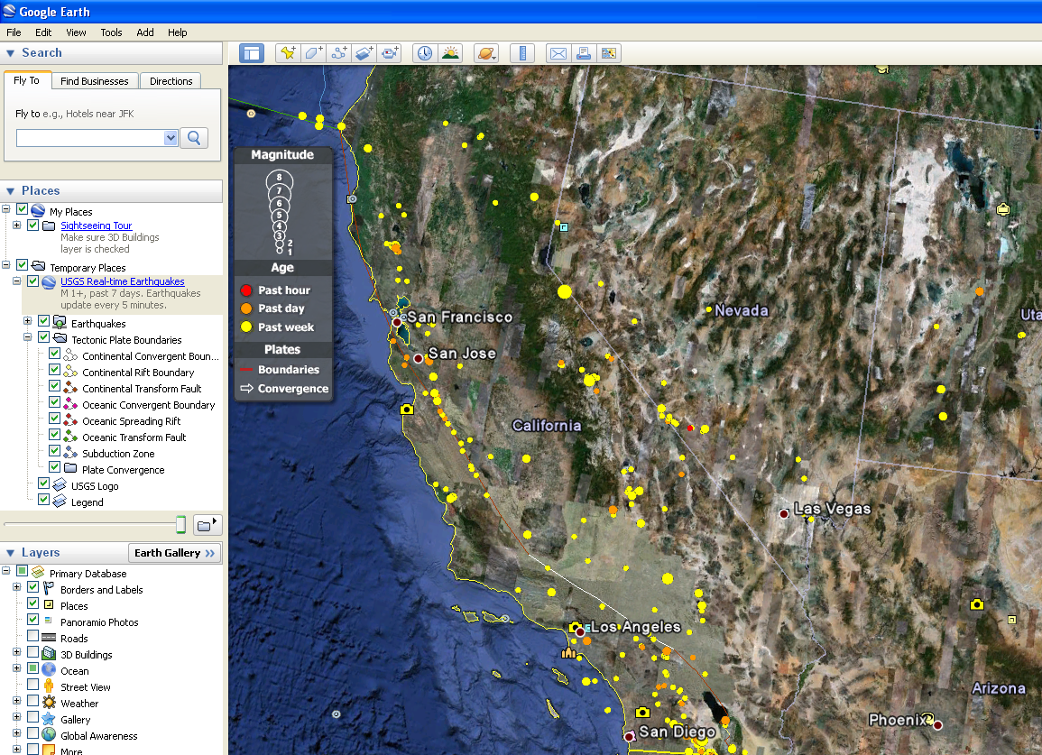
New Developments in GIS Technologies (Contd.)
4. Web-based Mapping and other Applications (Contd.)
Example: Sample Google Earth Files (KLM) (Click Here)
Google Earth is used to identify Real-time info. E.g. Earthquakes

Slide 15
New Developments in GIS Technologies (Contd.)
5. 3-D Visualization
  Information dissemination:
  Then – Minimal or didn’t exist
  Now – advanced and sophisticated with high resolution, color images, real-world object visualization
  Uses: information is viewed using
    3-D Maps
    Flythrough
    Flyover

Slide 16
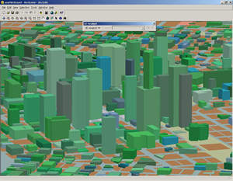
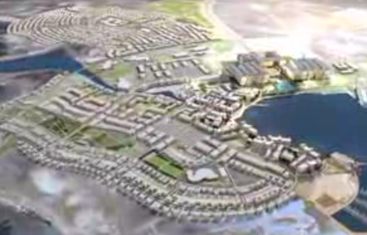
New Developments in GIS Technologies (Contd.)
5. 3-D Visualization (Contd.)
  Example:
SiteBuilder 3D is used to explore / visualize a development site for mixed land use development
Flyover 3-D visualization is used to show land development
View Animation

Slide 17
New Developments in GIS Technologies (Contd.)
6. Open source GIS (Free)
  Information dissemination:
  Then – didn’t exist. Nothing was free
  Now – free exchange of technology, software, data and methods for GIS
  Uses: technologies used for
    Mapping software
    Software development tools

Slide 18
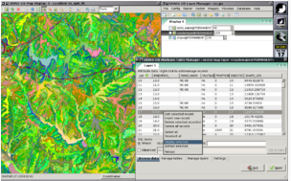
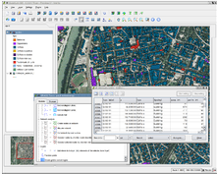
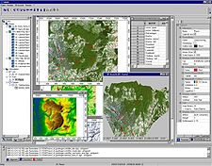
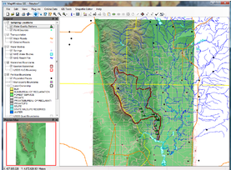
New Developments in GIS Technologies (Contd.)
6. Open source GIS (Free) (Contd.)
  Example: GRASS GIS, SAGA GIS, Quantum GIS, MapWindow GIS, gvSIG, JumpGIS

Slide 19
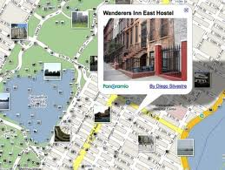
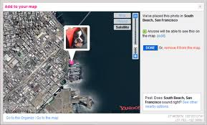
New Developments in GIS Technologies (Contd.)
New Development in GIS – Current Trend
(1) Smart Phones
Geotag: is the process of adding geographical identification metadata to various media such as photographs, video, websites, SMS messages, or RSS feeds

Slide 20
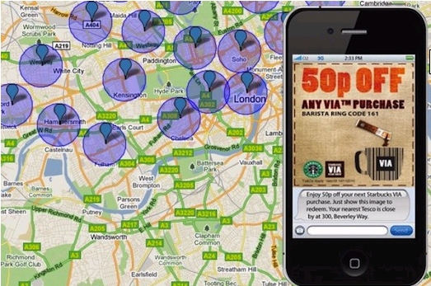
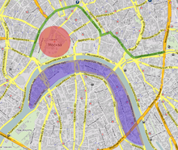
New Developments in GIS Technologies (Contd.)
New Development in GIS - Current Trend
(1) Smart Phones
(b) Geofensing: is a virtual perimeter for a real-world geographic area.

Slide 21
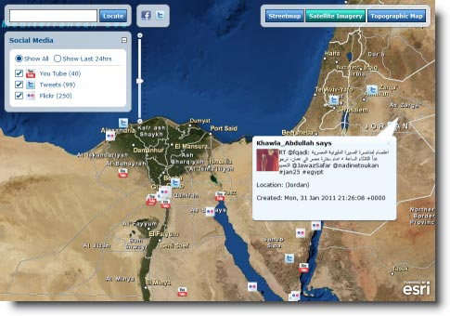
New Developments in GIS Technologies (Contd.)
New Development in GIS - Current Trend
(2) Crowdsourcing: outsourcing traditionally performed tasks to individuals, a group of people or community
Social Media
  Twitter
  Facebook
  Flickr
  Myspace
E.g. Real-time reporting of Egyptian unrest using social media and GIS

Slide 22
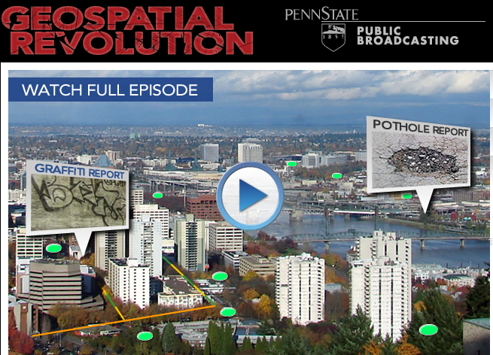
New Developments in GIS Technologies (Contd.)
Video: Episode 2 (3 Case Studies)
http://geospatialrevolution.psu.edu/episode2

Slide 23
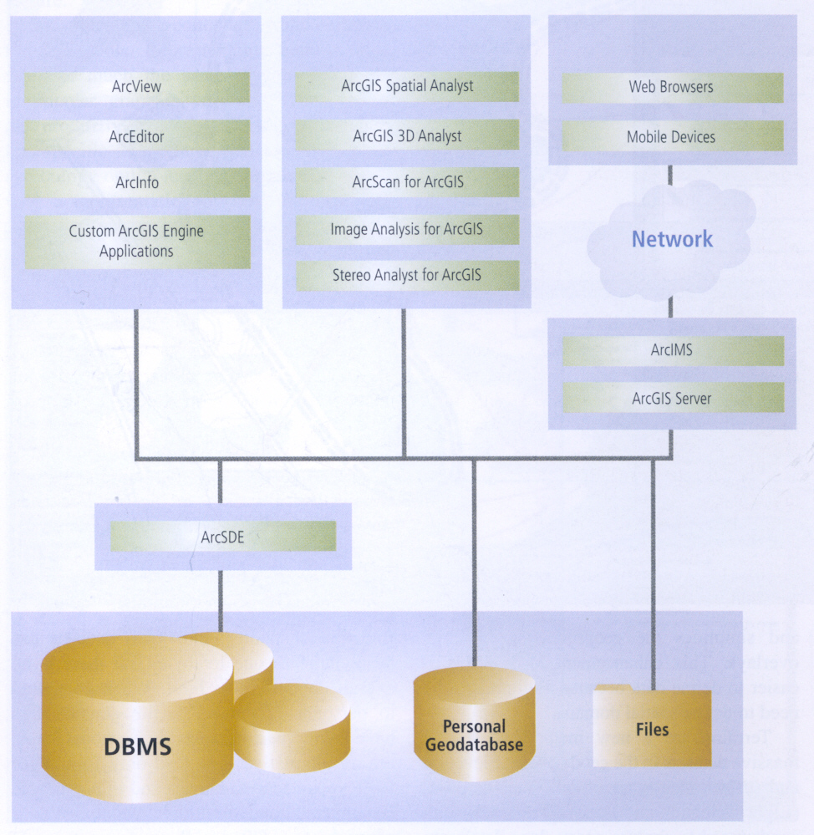
ArcGIS Framework - (ESRI)
GIS Extensions
GIS Client/Server Applications
GIS
On the Web
GIS
Database

Slide 24
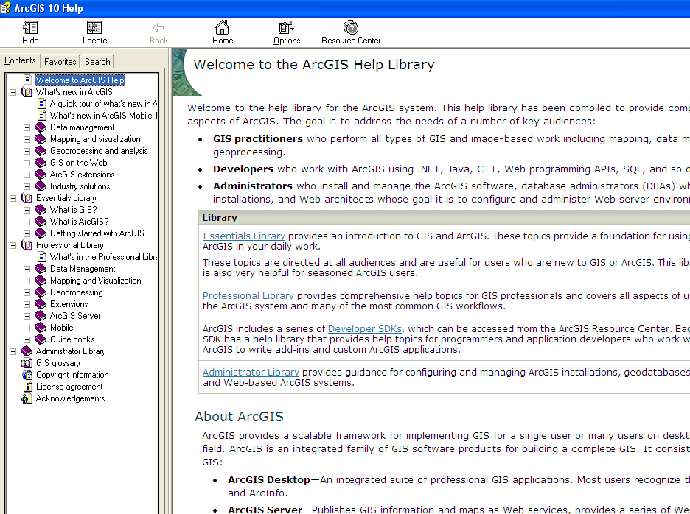
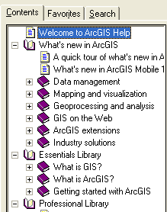
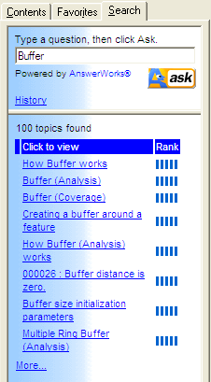
Resources (ESRI)
ArcView / ArcEditor/ ArcInfo Help

Slide 25
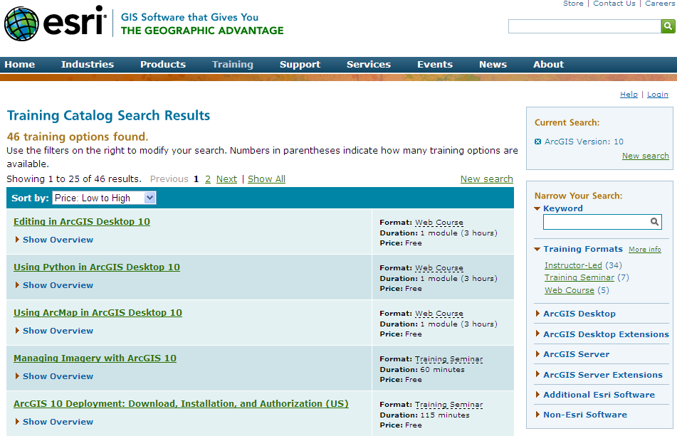
Resources (ESRI)…
ArcGIS Training (free) – Sort by Price. Pick ver 10.
http://training.esri.com/gateway/index.cfm?fa=search.results&searchterm=&search=Search&OrderBy=price asc&ArcGISVersion=10

Slide 26
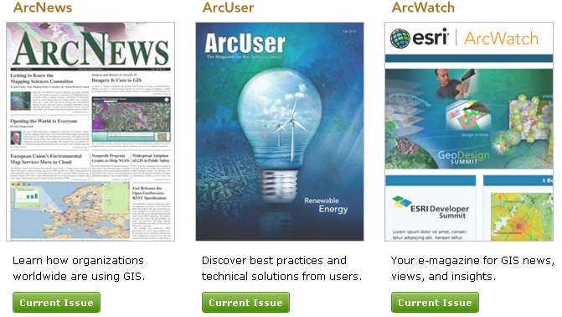
Resources (ESRI)…
Arc Magazines
ArcNews:
http://www.esri.com/news/arcnews/arcnews.html
ArcUser:
http://www.esri.com/news/arcuser/index.html
ArcWatch:
http://www.esri.com/news/arcwatch/index.html

Slide 27

Resources – Careers in GIS
http://gis.depaul.edu/geography/Careers_in_GIS.pdf
Other Links:
http://gis.depaul.edu/geography/
* From this link, select to Careers menu link to see the list
of sites that includes GIS jobs for public sector. For
Private sector jobs, you will have to search on sites like
monster, careerbuilder etc.

Slide 28
GIS Software
* Will work only on Windows
2-Month Evaluation Version:
ArcEditor with extensions (Free)
http://www.esri.com/software/arcgis/extensions/spatialanalyst/evaluate.html
Purchase Software
ArcInfo (incl. Extensions) – 1 year ($100)
ArcView – Permanent license – $1,500
ArcEditor – Permanent license – $7,000
ArcInfo – Permanent license – $14,000
  Phone: 1-800-447-9778 (ask for pre-sales)
  * You have to send a screen sot of your class schedule, contact information, University name etc.

Slide 29
GIS Certification
GIS Certification – Courses
  GEO 241 – GIS I
  GEO 242 – GIS II (Prerequisite GEO 241)
  GEO 344 – GIS III (Prerequisite GEO 242) – Offered only in Spring
  GEO 243 – Remote Sensing I
  GEO 391 – Research Techniques
Declaring GIS Certification
http://las.depaul.edu/geography/Programs/CertificateInGIS/index.asp
If you have questions about GIS Certification email Prof. Hwang (shwang9@depaul.edu ) or the Dept. Chair Prof. Euan Hague ( ehague@depau.edu )

Slide 30
GIS Certification - FAQ
1. When do you declare the GIS Certificate Program? Could it be done after taking 2-3 courses? YES
2. Can you declare it after taking all 5 courses (GEO241, 242, 243, 344 & 391)? YES
3. Could you substitute any research methods class for the GEO391? NO
4. Submitting the declaration form (http://condor.depaul.edu/~lasugrad/forms/majorform.html) will be sufficient or do you have to do anything else? NO, JUST THE FORM

Slide 31
Next Week – (Week 10) IMPORTANT!!!
Final Exam
- Theory & Practical
- Whatever we have covered so far from day 1
- Open book
Final Paper due November 15 at 12 midnight

